Slide 1
The First 5 Years of the IMPACT Collaboratory: Building an infrastructure to Conduct ePCTs in Dementia Care
Susan Mitchell, MD, MPH – Hebrew SeniorLife’s Hinda and Arthur Marcus Institute for Aging Research
Vincent Mor, PhD – Brown University School of Public Health

Slide 2
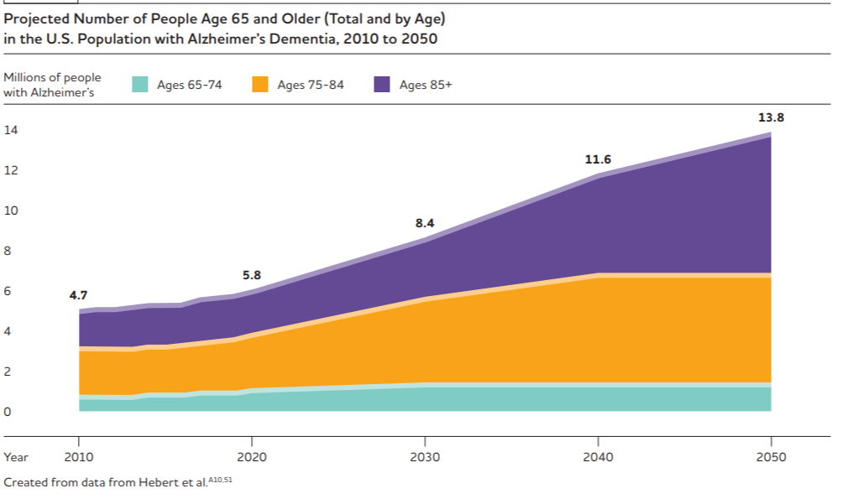
Background
>5 million with AD/ADRD; increasing
Urgent public health need to provide care to PLWD and care partners
Non-pharmacological interventions have efficacy but limited adoption
ePCTs potential to accelerate translation of interventions into clinical practice

Slide 3
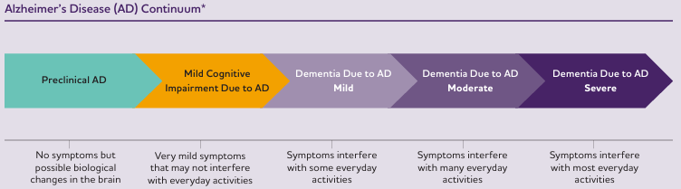
Dementia Stages

Slide 4
Background
Shortcoming of traditional RCTs
  Stand-alone settings
  Non-diverse populations
  Underpowered
  Expensive
  Not applicable to “real-world”
Disconnect between research and clinical care

Slide 5
Pragmatic Trials: Key Attributes
 | Explanatory | Pragmatic
Question | Efficacy—can the intervention work? | Effectiveness—does the intervention work in practice?
Setting | Well resourced, “ideal” setting | Normal practice
Randomization | Usually individual | Usually clustered
Participants | Highly selected | Little selection
Intervention | Strict enforcement and adherence monitoring | Applied flexibly as in normal practice
Comparator | Placebo/Non-treatment | Real-world alternatives
Outcomes | Short-term surrogate measures | Directly relevant to stakeholders
Data Collection | By researchers outside of clinical care | By clinicians/administrators at point of care
Stakeholder engagement | Not much, driven by investigators/sponsors | Input from varied stakeholders at all stages

Slide 6
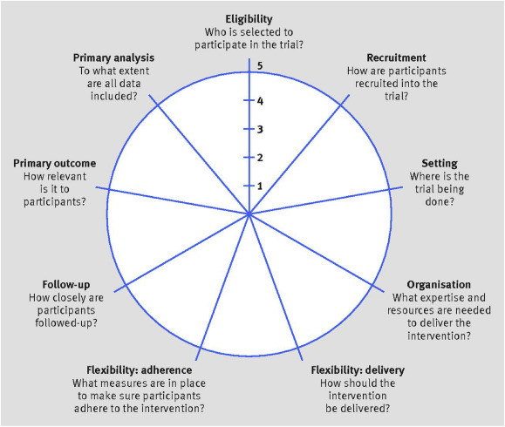
PRECIS-2

Slide 7
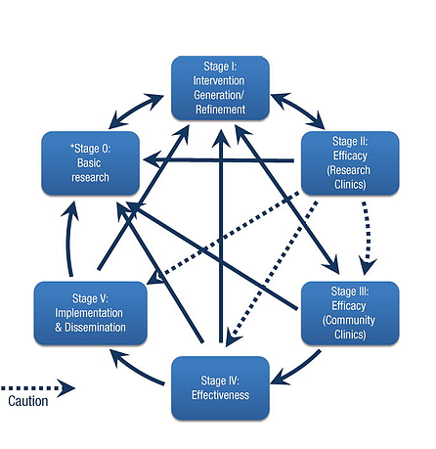
Stage of Intervention Development

Slide 8
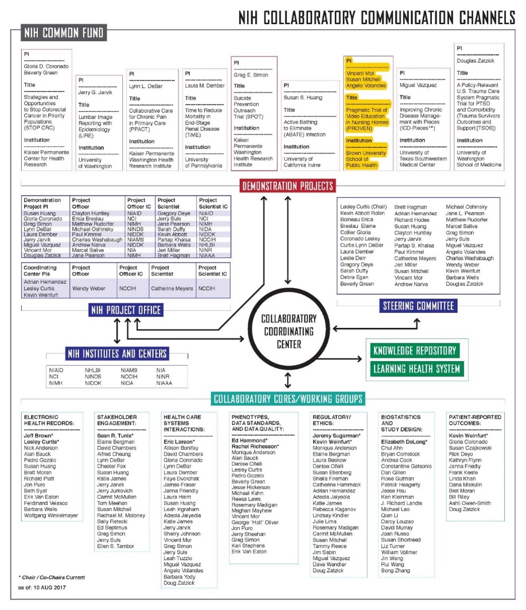

Background
Established 2012
Developed knowledge base for ePCTs
Supported large demonstrations
Broad content from all medical disciplines

Slide 9






ePCTs in Dementia Require Special Focus
HEALTH CARE SYSTEMS
Nursing homes
Assisted living
Home health
Rehab
Hospice
Hospital
DATA SOURCES
Medicare
Minimum DataSet
EHRs
ETHICS/
REG
Vulnerable
Consent capacity
Federal-wide assurance
OUTCOMES
PLWD
Care partners
HCS
Ascertaining from datasets
DESIGN/
STATS
Cluster RCT
Dyadic
Loss to follow-up
IMPLEMENT
Complex interventions
Challenging settings
Adherence

Slide 10

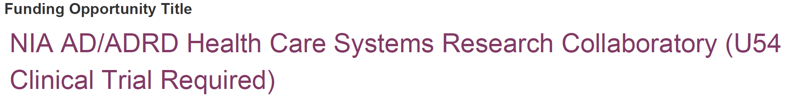
Background

Slide 11
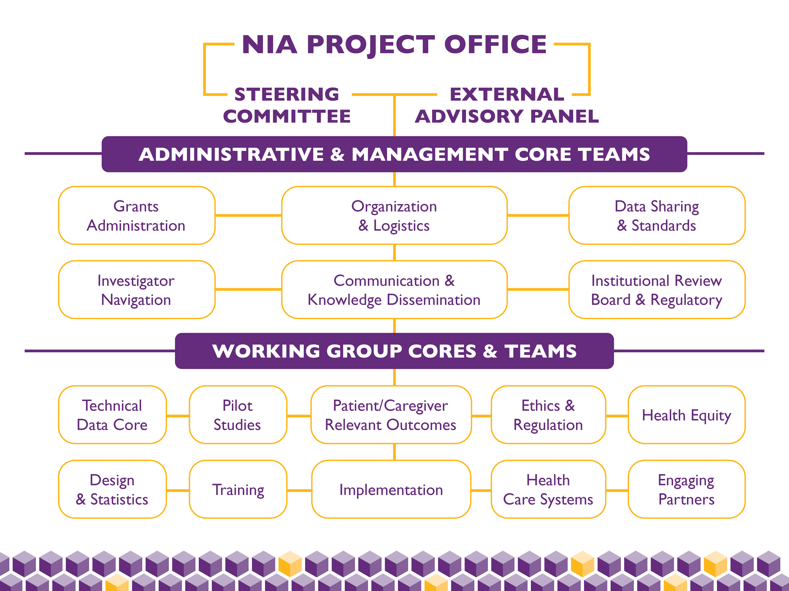
Governance Structure

Slide 12
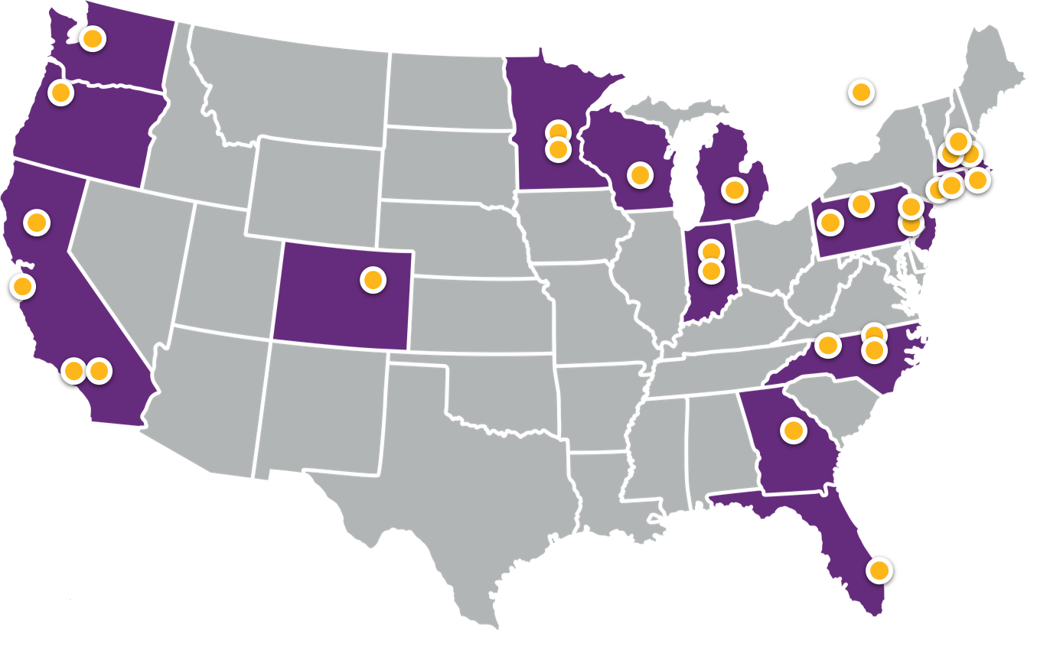
Who are we?
Aetna
Brown University
Carnegie Mellon University
Florida Atlantic University
Drexel University
Duke University
Emory University
Eskenazi Health
Harvard Pilgrim Health Care Institute
Harvard University
HealthCore
Health Partners Institute
Hebrew SeniorLife
Humana
Icahn School of Medicine at Mount Sinai
Indiana University, Regenstrief Institute
Kaiser Foundation Health Plan of Washington
Kaiser Permanente Colorado Institute for Health Research
Massachusetts General Hospital
Meyers Primary Care Institute
New York University
Oregon Health & Science University
Ottawa Hospital Research Institute
Pennsylvania State University
University of California, Los Angeles
University of California, Davis
University of California, San Francisco
University of Connecticut
University of Michigan
University of Minnesota
University of North Carolina at Chapel Hill
University of Pennsylvania
University of Wisconsin
University of Southern California
Wake Forest University
Yale University
More than 60 investigators from over 30 institutions…

Slide 13

Mission
To build the nation’s
capacity to conduct ePCTs
of interventions within
health care systems (HCS) for
people living with dementia (PLWD)
and their care partners (CPs)
Vision
To transform the delivery,
quality, and outcomes of care
provided to PLWD and their CPs
by accelerating the testing
and adoption of evidence-based
interventions in HCS
Values
Be Collaborative
Be Generative
Be Inclusive
Be Excellent
Be Transformative
Be Sustainable

Slide 14

Fulfilling the Mission

Slide 15
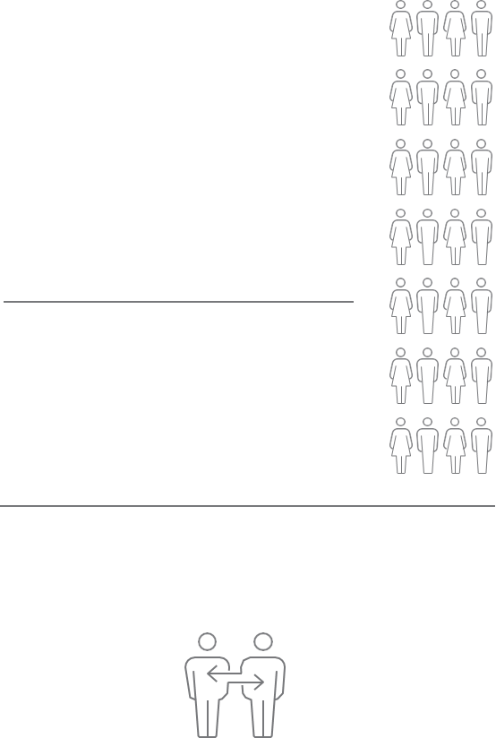











IMPACT Accomplishments
Support Design & Conduct of ePCTs
Develop & Disseminate Knowledge
Building Investigator Capacity
Catalyze Community Collaboration
National Competitions
for ePCTs
11
Cycles
Knowledge Repository
Featured Products
10 Cycles
National Competitions for Investigator Training
Learning Health Network
36
189 Peer reviewed articles
4 Best practice/guidance
6 Reports
50 Grand Rounds
51 Podcasts
410
Items
Organizations
Pilot Grant Program
8 Request-for-applications (RFAs)
23 Grants awarded
Career Development
Award Program​
5 RFAs​
12 Awardees
4 Communities
58 Members
JAGS Special Issue
Demonstration Projects Program
3 RFAs
6 Grants awarded
11 Articles
Health Care Systems Scholars Program
4 RFAs
7 Awardees
Stakeholder Advisory Committee
6
Real World Data Scholars Program
1 RFA
4 Awardees
13
Organizations
iLibrary Searchable Databases
Patient and care partner outcomes:
  Real world data
  Clinical assessments
Dementia care interventions:
Telehealth
Formal care partner
Informal care partner
Identifying people living with dementia from real world data
Investigator Consultation
Lived Experience Panel
123
Applicant consultations
Alzheimer’s Association collaboration
ePCT Video
Learning Library
10 Topic areas
2 Certificate programs
ePCTs Basics
Health Equity Best Practices
Faculty Scholars
Program
3 Cycles
38 Scholars
14 Panelists
41
Funded investigator consultations
6 People living with dementia
5 Care partners
3 Proxies
4 Training Workshops 2021-2024
11
Scientific Meetings & Workshops
4
2 Patient & Caregiver Relevant Outcomes
1 Ethics & Regulation
1 Health Equity (Spanish translation available)
44
Videos
Topics
5 Scientific Meeting Symposia
6 IMPACT Themed Workshops
317 Participants
94 Institutions
16 Meetings
Notes:
Applicant consults = all LOI consults (first and second pilots (69), targeted for pilots (30) and demos(13), group demo (11))
Funded investigator = NIA + ALL IMPACT funding mechanisms (41 total, including 11 NIA-funded)
Pull out NIA funded in small
Expert hours from 2A on and ALL including individual consults (both LOI and funded)= groups 764 + 111 = 875
TRAINING WORKSHOP ATTENDEES – double count people as many times as they attend
2021-64 attendees
2022-87 attendees
2023-79 attendees
Counting active cycles for CDAs and HCS Scholars for funded
As of October 2023
KR numbers as of 8/30/24
508 items – counting 2 items for each podcast and 2 for each grand rounds
Will be 511 – because missing 4 snapshots I will add (Li, Parchman, Kiselica, Murali) – subtracting 50 GR slides and 51 transcripts and removing – 1 for external resource (sociocultural…) that needs to be removed
410 (511, - 52 transcripts, -48 slides (note GR 32 slides/recording not included b/c we did not get permission, LTC data coop has a transcript and no slides), -1 RFA
4 best practices : HE bp doc, dyadic design, stakeholder perspectives, value prop
50 Grand rounds (48 regular, 2 covid)
51 podcasts (48 regular, 2 covid, 1 special pilot convo)
4 reports originally (but should this be 6? 2 PCRO, 1 HE (don’t count Spanish), 1 ERC, 1 CAPRA, 1 SAC meeting report??)

Slide 16


Support Research: Grant Mechanisms
Pilot Studies Grant Program
2 Requests for Applications (RFAs) annually
$200k in direct costs for 1 year
Goal: Pilot study to prepare for an embedded pragmatic clinical trial
(ePCT) of a non-pharmacological interventions for dementia care
Demonstration Projects Grant Program
Annual RFA
$500k in total direct costs for 18-24 months
Goal: Full-scale ePCT in health care systems of non-pharmacological
interventions for dementia care

Slide 17
Support Research: Grant Mechanisms
Pilot Grants
8 RFAs
23 Grants awarded
Demonstration Projects
3 RFAs
6 Grants awarded
Investigator Consultations
123 Applicant ​consultations
41 IMPACT investigators consultations
7 Ask an IMPACT Expert consultations
3 Dementia Prevalence Estimate consultations
~875 Expert hours
Notes:
Applicant consults = all LOI consults (first and second pilots (69), targeted for pilots (30) and demos(13), group demo (11))
Funded investigator = NIA + ALL IMPACT funding mechanisms (41 total, including 11 NIA-funded)
Expert hours from 2A on and ALL including individual consults (both LOI and funded)= groups 764 + 111 = 875
3 dementia prevalence estimates consults
As of August 2024

Slide 18
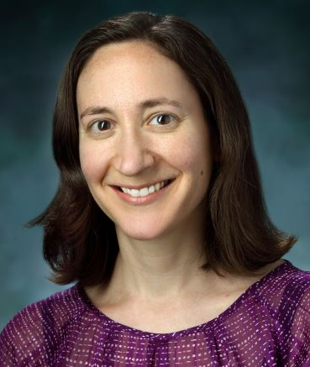
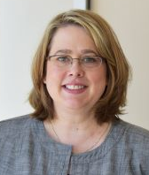

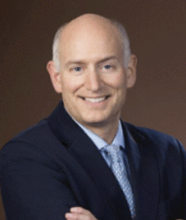
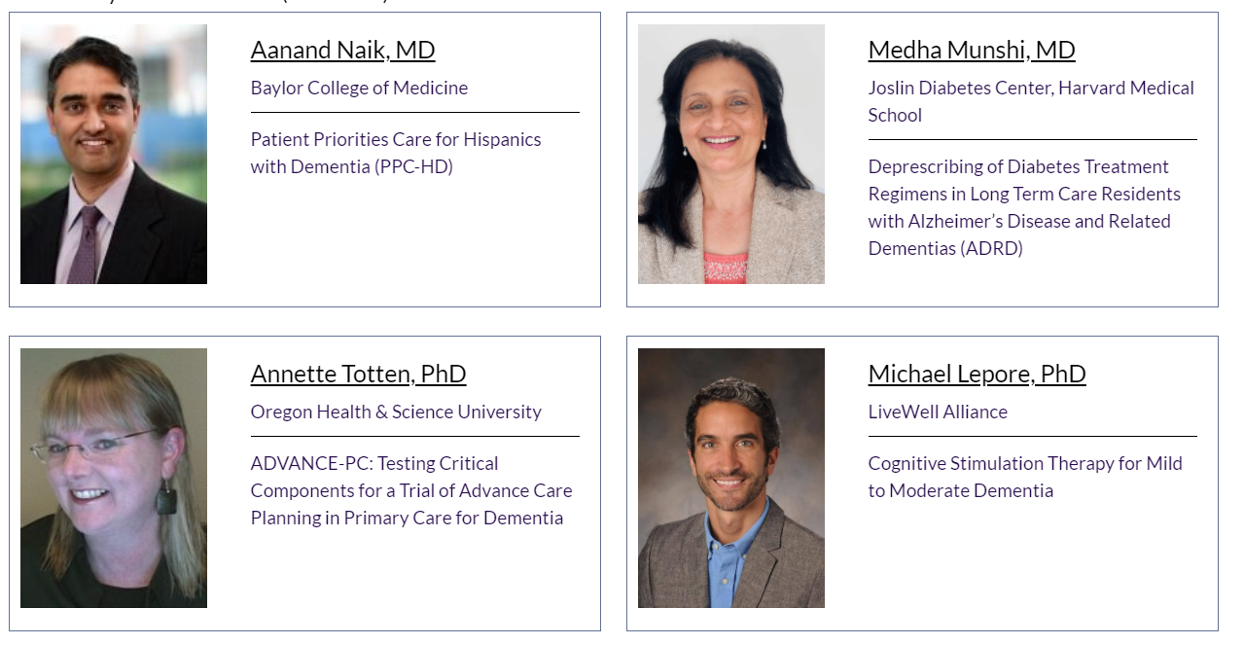
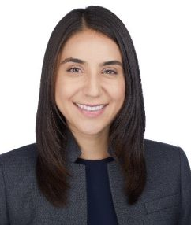

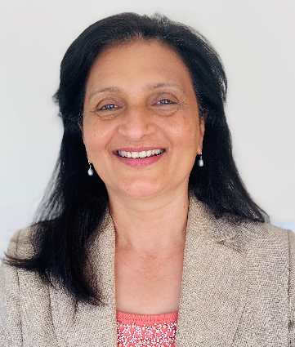
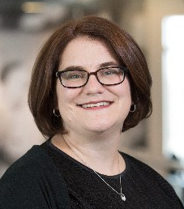
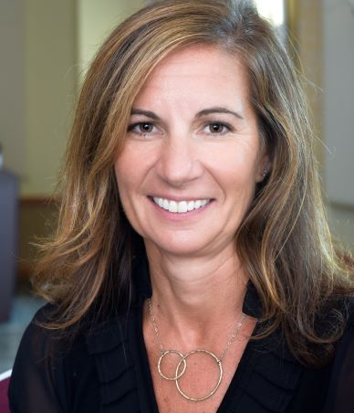
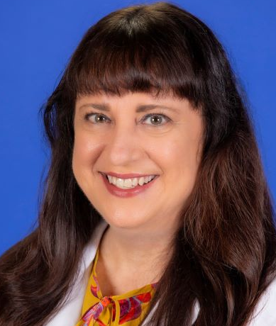
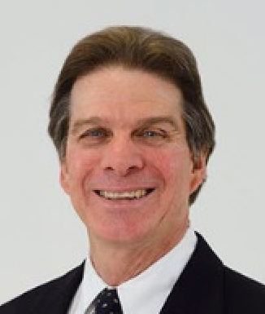
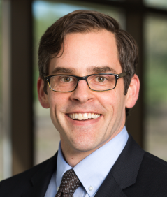
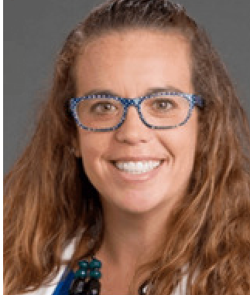

Pilot Grant Awardees
Ariel Green, MD, MPH, PhD
Johns Hopkins University
Leah Hanson, PhD HealthPartners Institute
Katherine Abbott, PhD, MGS
Miami University (Oxford, OH)
Cycle 2A
Cycle 3A
Cycle 4A
Brent Forester, MD, MSc
Mass General Brigham
Michael Lepore, PhD
University of Maryland
Magaly Ramirez, PhD, MS
University of Washington
Scott Dresden, MD, MS
Northwestern University of Feinberg School of Medicine
Cycle 1
Cycle 2B
Cycle 3A
Cycle 4B
Ula Hwang, MD, MPH
Yale School of Medicine
Medha Munshi, MD
Joslin Diabetes Center
Jennifer Carnahan, MD, MPH, MA
Indiana University
Teresita Hogan, MD
University of Chicago
Cycle 1
Cycle 2B
Cycle 4B
Cycle 3B
Joan Carpenter, PhD, CRNP
University of Maryland
Aanand Naik, MD
Baylor College
Helen Kales, MD
University of California, Davis
Julie Lauffenburger, PhD
Brigham and Woman’s Hospital
Cycle 2A
Cycle 2B
Cycle 3B
Cycle 5A
Richard Fortinsky, PhD
University of Connecticut
Annette Totten, PhD
Oregon University
Donovan Maust, MD, MS
University of Michigan
Ellen McCreedy, PhD
Brown University School of Public Health
Cycle 2A
Cycle 2B
Cycle 3B
Cycle 5A
Jennifer Gabbard, MD
Wake Forest
Elizabeth Ciemins, PhD
AMGA
Elizabeth Phelan, MD, MS
University of Washington
Veronica Yank, MD
University of California San Francisco (UCSF)
Cycle 2A
Cycle 3A
Cycle 3B
Cycle 5A

Slide 19
Support Research: What is a Feasibility/Pilot study?
Aims should address key aspects that require feasibility testing for full scale ePCT:
  Aim 1: Intervention implementation
  *Aim 2: Subject identification/enrollment using pragmatic approach
  *Aim 3: Clinical outcome ascertainment using a pragmatic approach
* Must be feasible in intervention and control (future) arm *
Notes:
This Team based consultation model also allowed us to come together as a collaboratory to have gernal agreement on what is a pilot for an ePCT and the aims for a pilot study
General suggestions, many ways to do this, and should be specific to address needs for moving to/designing a full-scale ePCT

Slide 20
Support Research: Consultation Process
Form Consult
Teams ~ 6
Mitchell Teams
Mor Teams
LOI Review
Team Pre-Consultation Meeting
Discuss/Revise Consult Worksheet
1st Team Consultation Meeting
Review of Consult Worksheet
2nd Team Consultation Meeting
Review of Specific Aims
Applications Due!
Teams Formed
Feb
Mar 30
Apr 17-21
Apr 24-28
May 16-24
Jun 16
Team Lead +
IRB. DSC, IC, PCRO, ERC, TDC
Additional Cores as needed
LOIs Approved by committee
Teams assigned tailored to needs
9
Notifications w/teams & dates
Consult Team Only
Team Lead completes consult Worksheet
Sent to PI & team
PI + Biostatistician
Consult worksheet reviewed
Address questions / concerns from PI
PI + Biostatistician
Specific Aims Page reviewed
Address questions / concerns from PI
Full proposals submitted
Targeted consultation w/Cores & Teams available

Slide 21
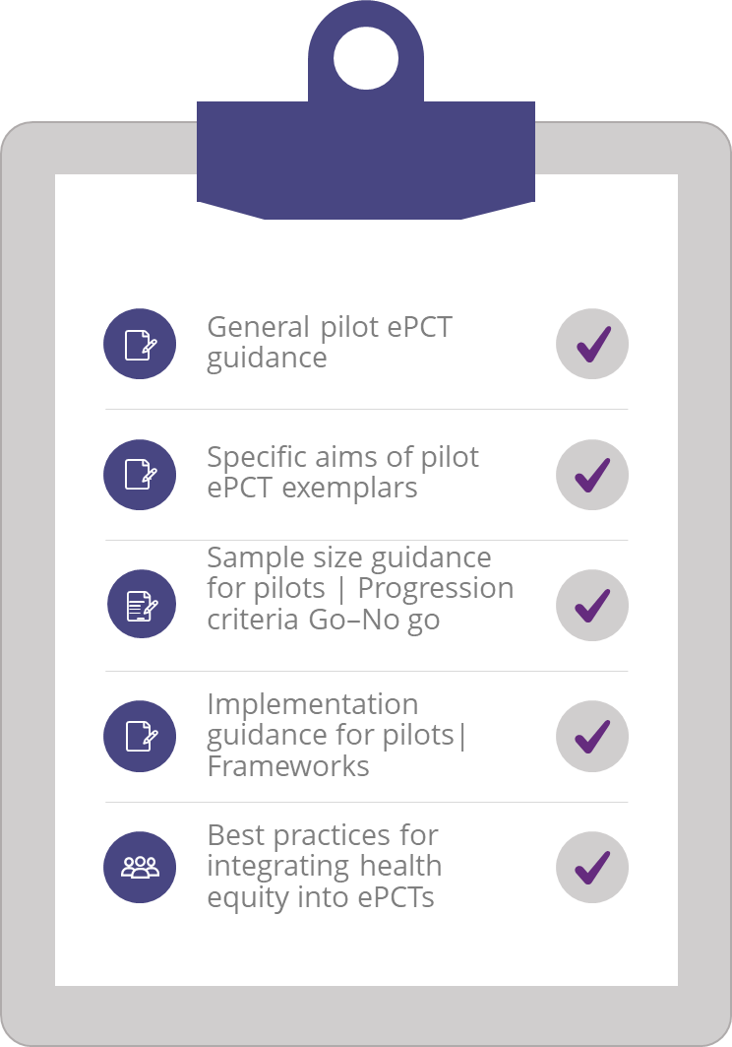
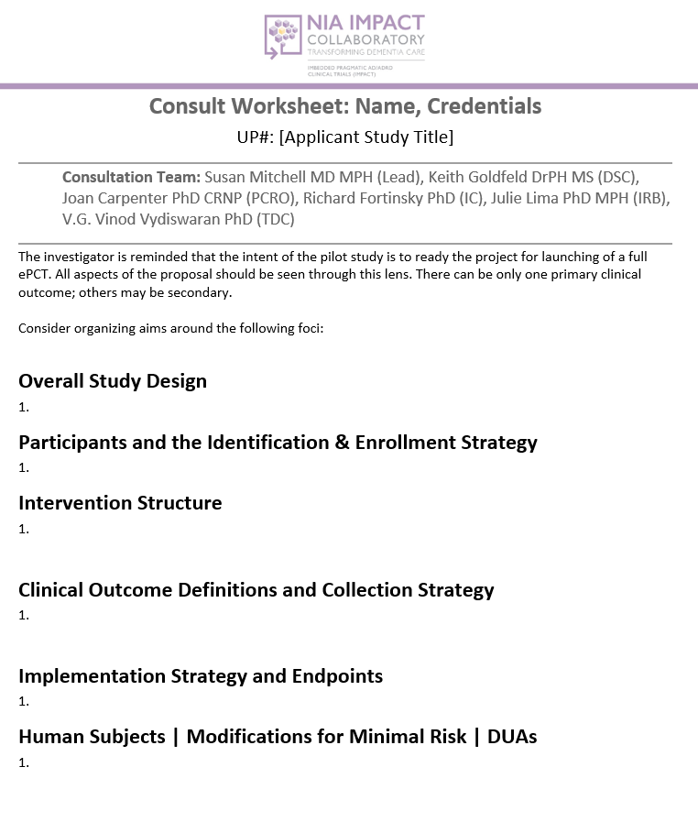
Support Research: Consultation Process
Applicant Portal

Slide 22


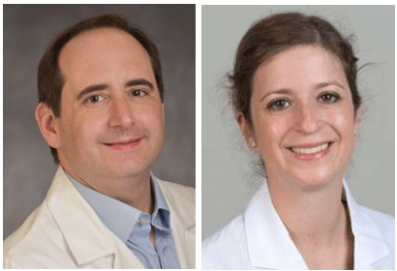



Demonstration Project Awardees
Xiaojuan Li, PhD & Richard Platt, MD, MSc
Harvard Medical School;
Harvard Pilgrim Health Care Institute
Collaborative Care Coordination Program for Alzheimer’s Disease and Related Dementias (Co-CARE-AD)
Michael Parchman, MD, MPH
Kaiser Permanente of Washington Health Research Institute
Can Value Champions Reduce Inappropriate Prescribing for People with Dementia?
Cycle 1
Cycle 1
Ira Hofer, MD & Susana Vacas, MD, PhD
Icahn School of Medicine;
Massachusetts General Hospital
Mitigation of Postoperative Delirium in High-Risk Patients
Lisa Kern, MD, MPH
Weill Cornell Medicine
Improving How People Living with Dementia are Selected for Care Coordination: ePCT in an Accountable Care Organization
Cycle 2
Cycle 2
Alexia Torke, MD, MS & Nichole Fowler, PhD MHSA
Indiana University School of Medicine
The Aging Brain Care Virtual Program
Ariel Green, MD, MPH, PHD
Johns Hopkins University School of Medicine
ALIGN: Aligning Medications with What Matters Most
Cycle 3
Cycle 3

Slide 23

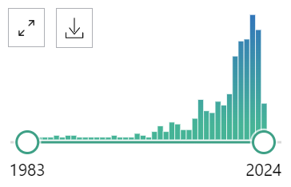
Knowledge Generation to Advance Field
2019:
  Limited knowledge base
  Not dementia focused
2019-24: Steps taken to address…
  Synthesized available knowledge
  Started with basics
  Multiple modes of dissemination
  Collated in knowledge repository
    ~ 400 items
1983-2018, N=143 2019-2024, N=250

Slide 24
Knowledge Generation: Key Accomplishments
Appropriate use of waivers of consent
Identifying PLWD from health care generated data
Integrating health equity in ePCTs
“Dent” in outcomes
Practical data tools

Slide 25
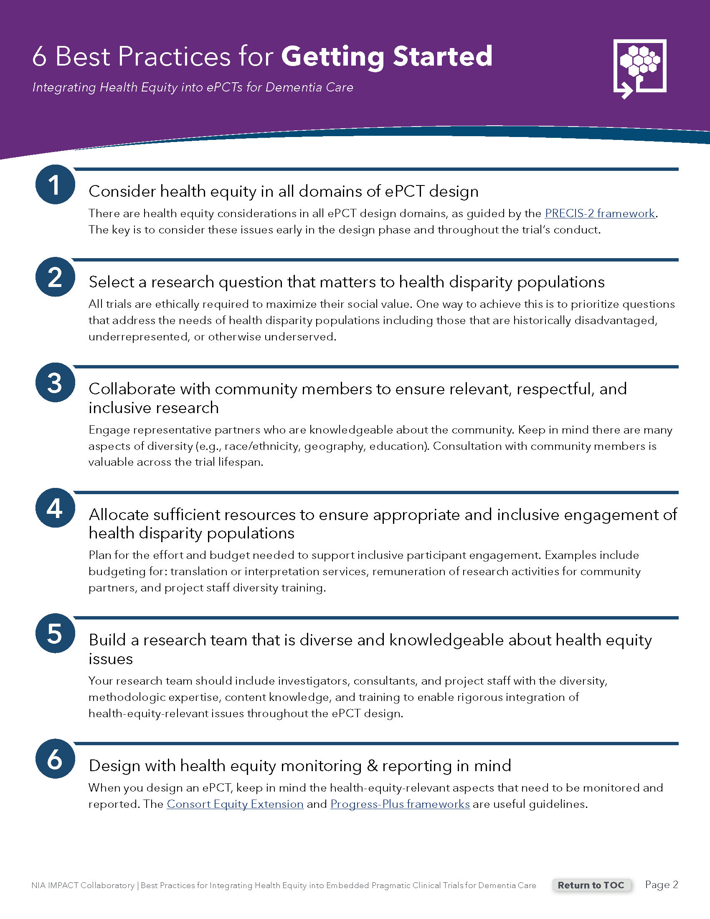
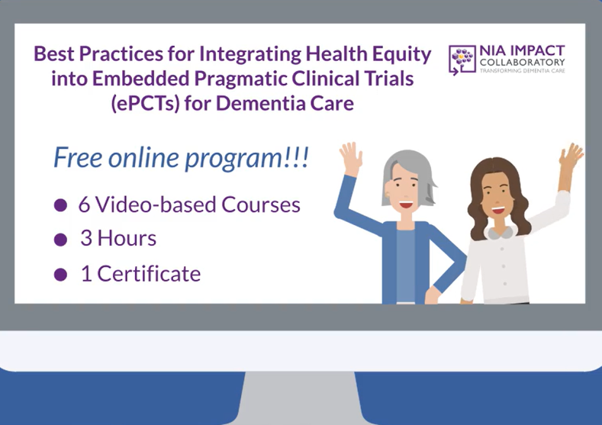
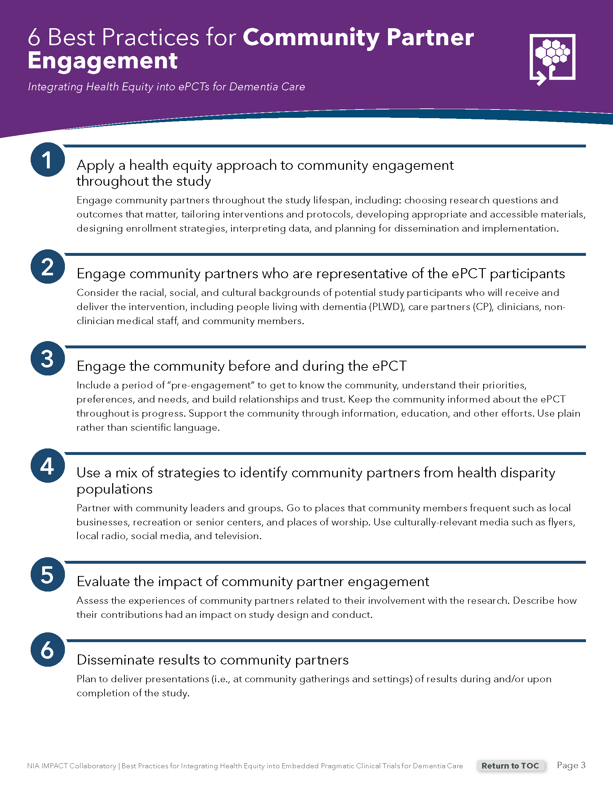
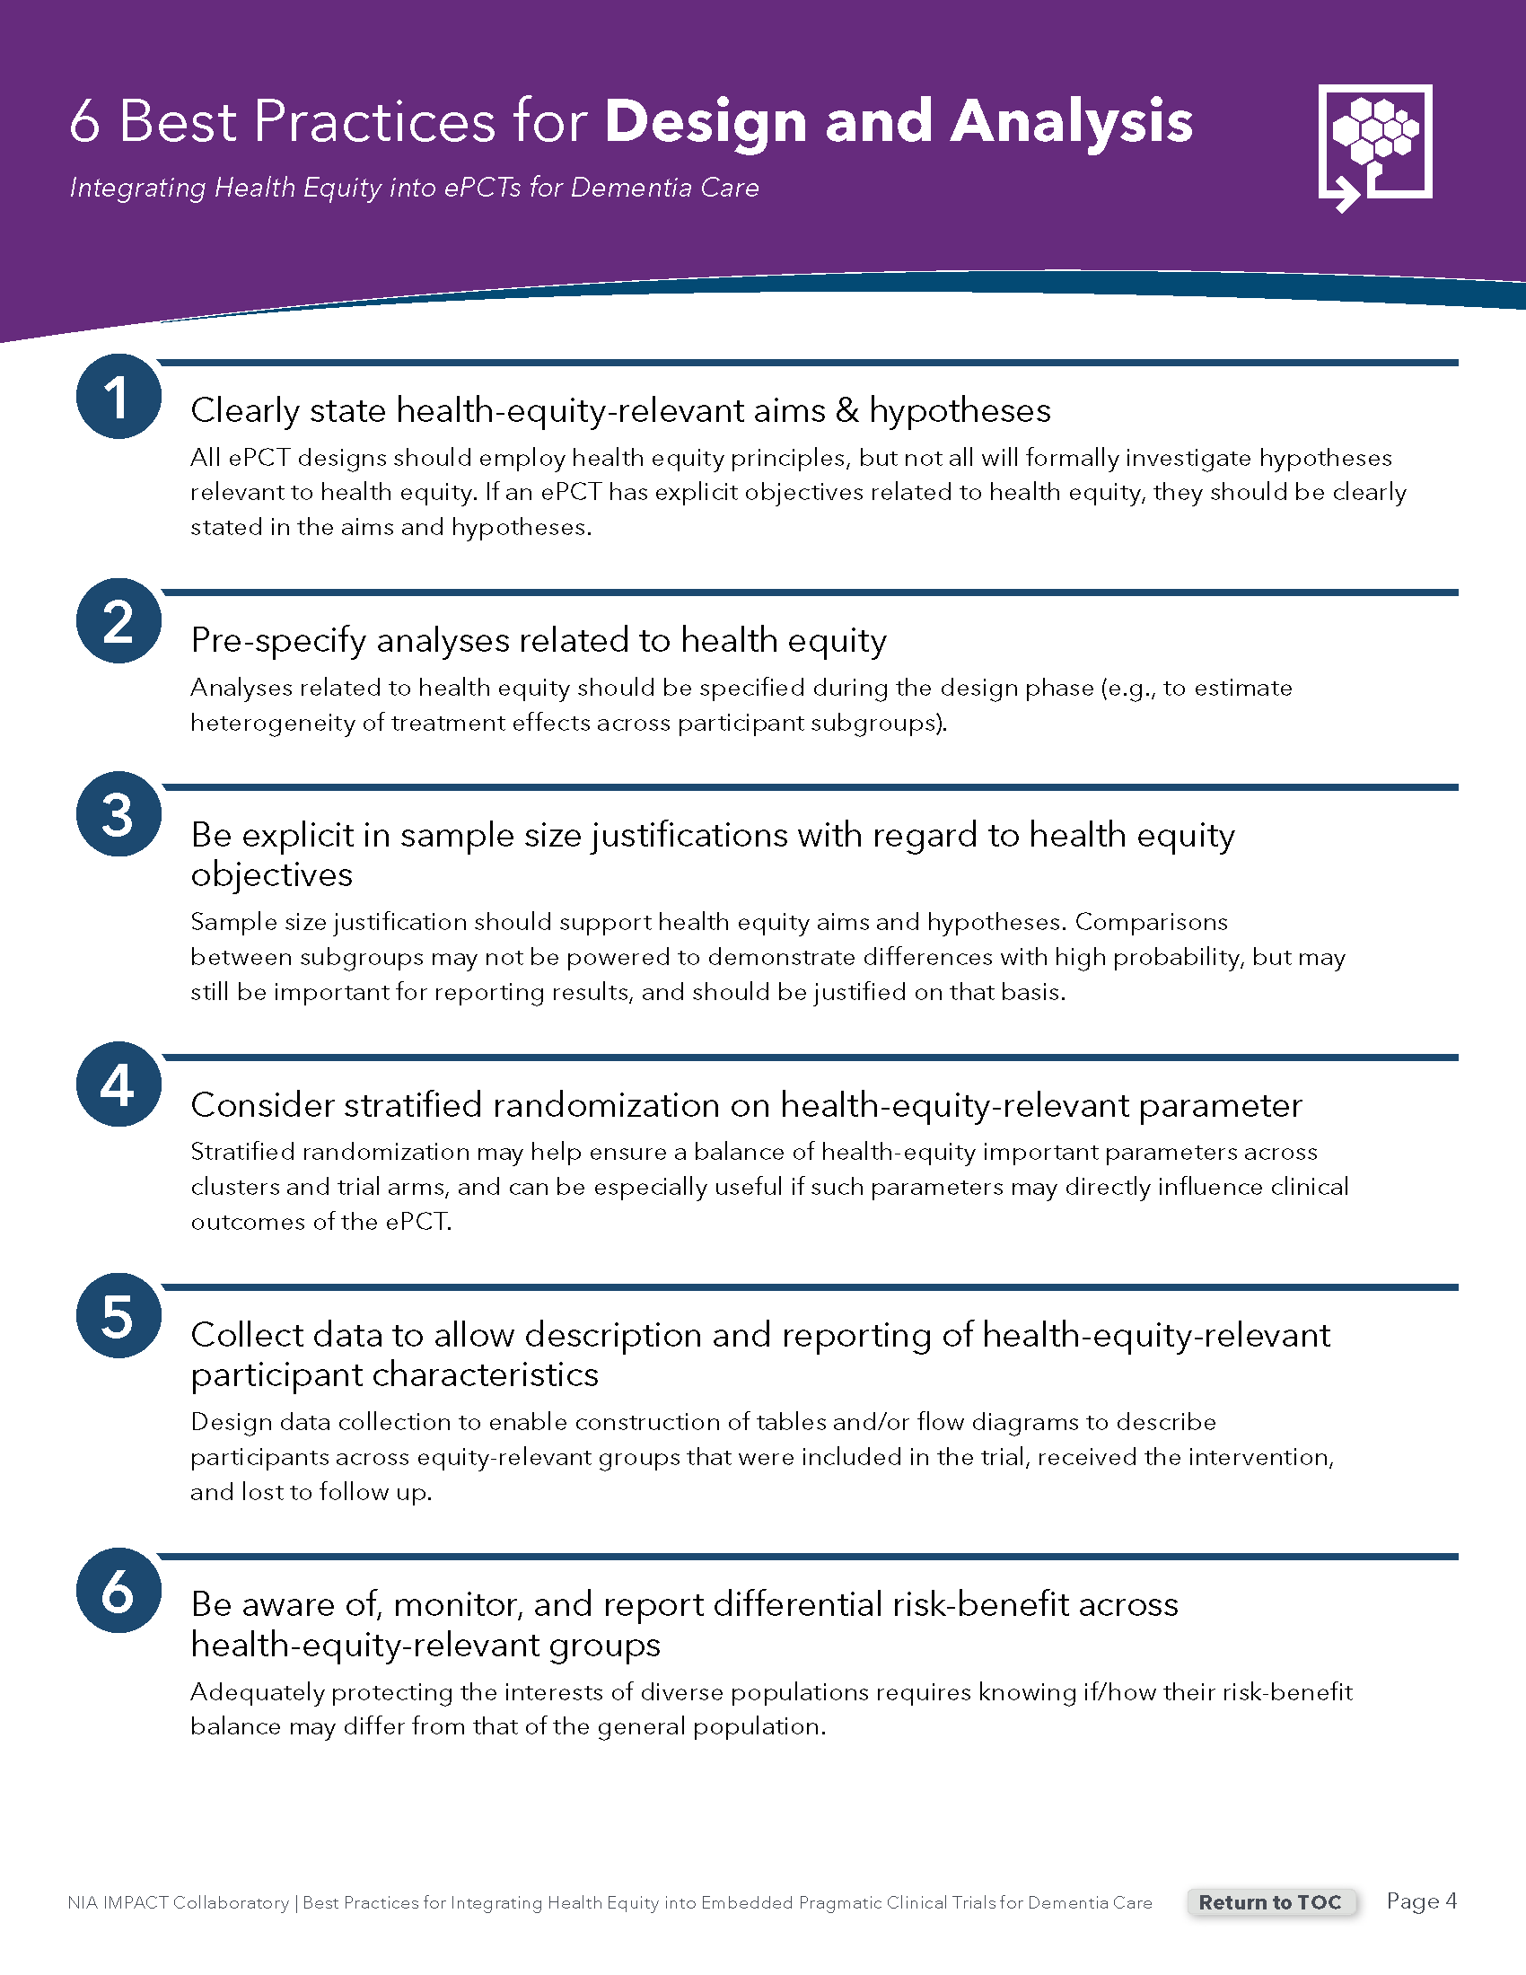
Best Practices for Integrating Health Equity in ePCTs

Slide 26
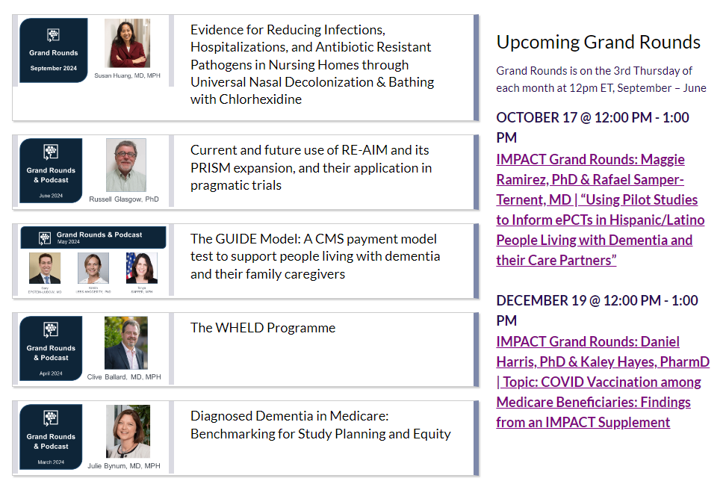
Generate Knowledge: Grand Rounds & Podcasts
Monthly grand rounds and podcasts highlight research and activities pertinent to ePCTs in PLWD and CPs

Slide 27

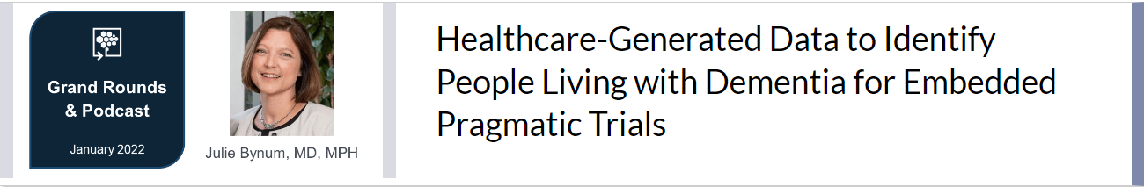
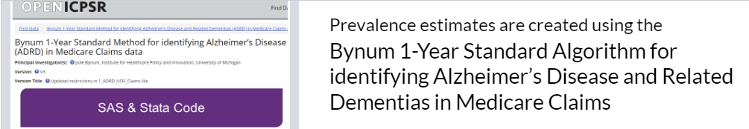
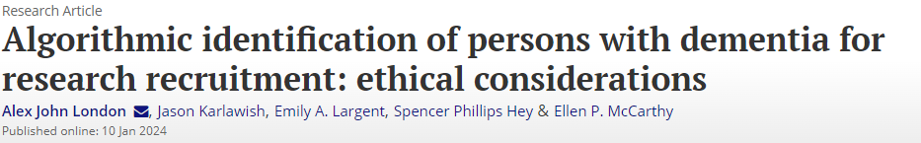
Generate Knowledge: Algorithms to Identify PLWD
Sought after consult advice
Workshop
Validated algorithms using health care generated data
Ethical Considerations

Slide 28
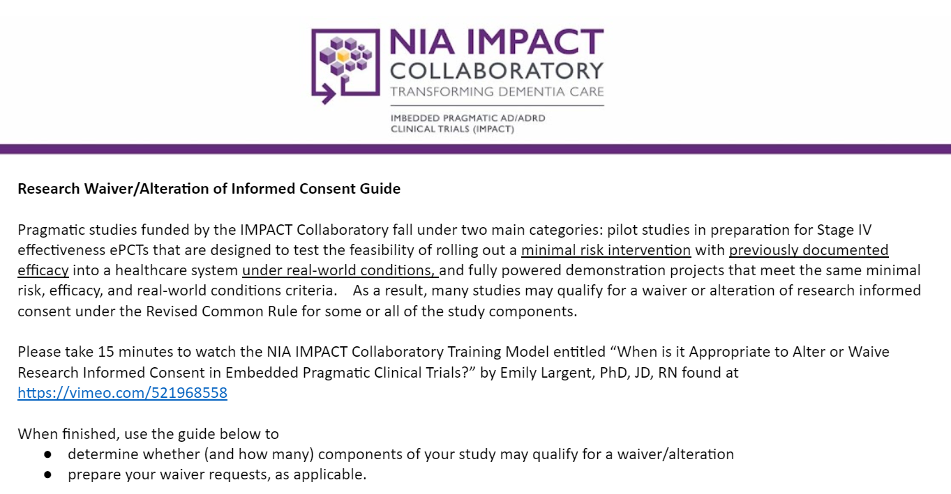
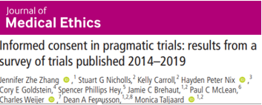

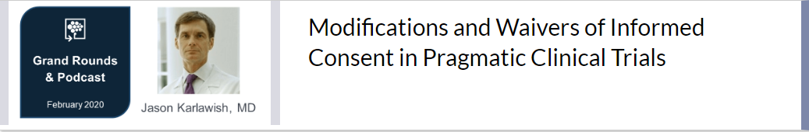
Generate Knowledge: Waivers of Consent

Slide 29
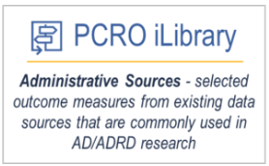

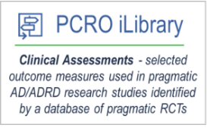
Generate Knowledge: Outcomes
ePCT success depends on primary outcome
Tension: Important versus pragmatic
Outcome selected often a compromise
IMPACT “first” steps
  What is out there? Two iLibraries
  What do PWLD/CP think? LEP
  What is possible? Preliminary work
  with NH EHR

Slide 30
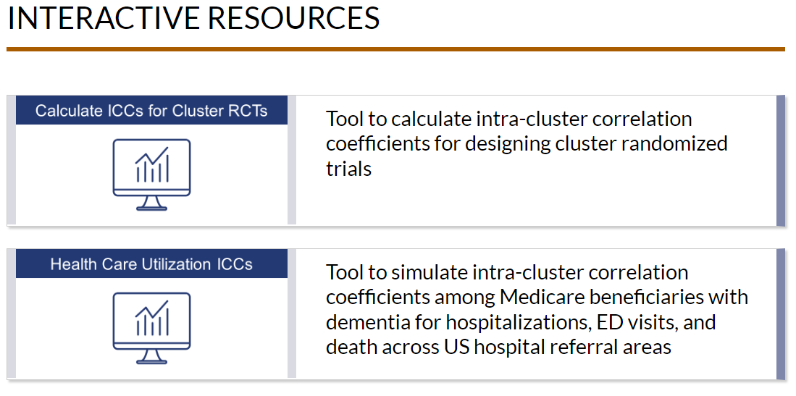
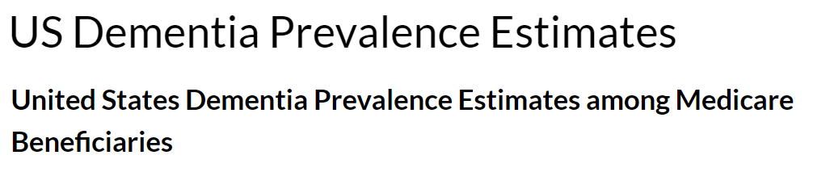
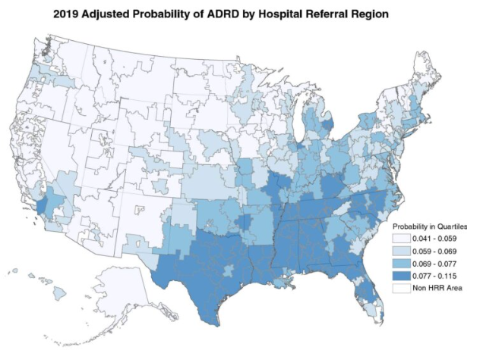
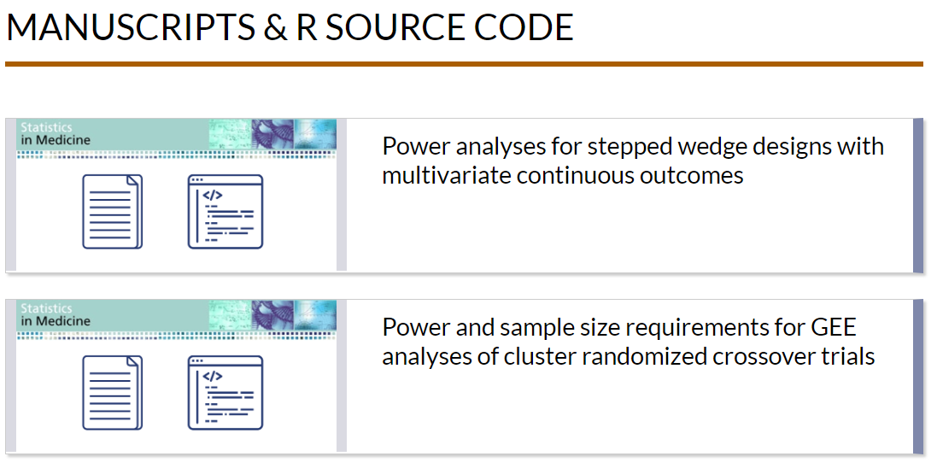
Generate Knowledge: Practical Data Tools

Slide 31
Build Investigator Capacity
2019:
  Few experienced investigators in ePCTs, fewer in dementia
  No dedicated training mechanisms
  Challenges
    ePCT conduct often later in career
    ePCTs require robust infrastructure limiting institutions
    Few mentors
2019-24: Steps taken to address…

Slide 32
Build Investigator Capacity: Key Accomplishments
Created opportunities for trainees from less well-resourced institutions
Supported trainees by varied mechanisms
Created a community/network for trainees
Provided training through varied modalities
Notes:
Update community pic

Slide 33
Investigator Capacity: Diverse Mechanisms
Career Development
Award
Faculty Scholars
Mentored training for early career investigators
Experiential training for early to mid-career investigators
Health Care Systems Scholars
Real World Data Scholars
Y2
Y4
Y1
Y3
Y5
Immersion into HCS for mid-career investigators
Mentored training for “data-type” early career investigators in real-world-data

Slide 34
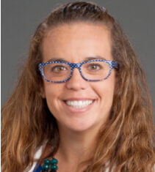
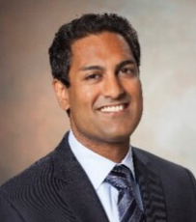
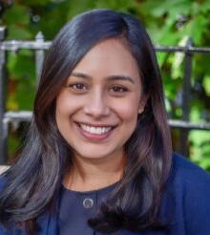
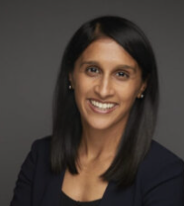
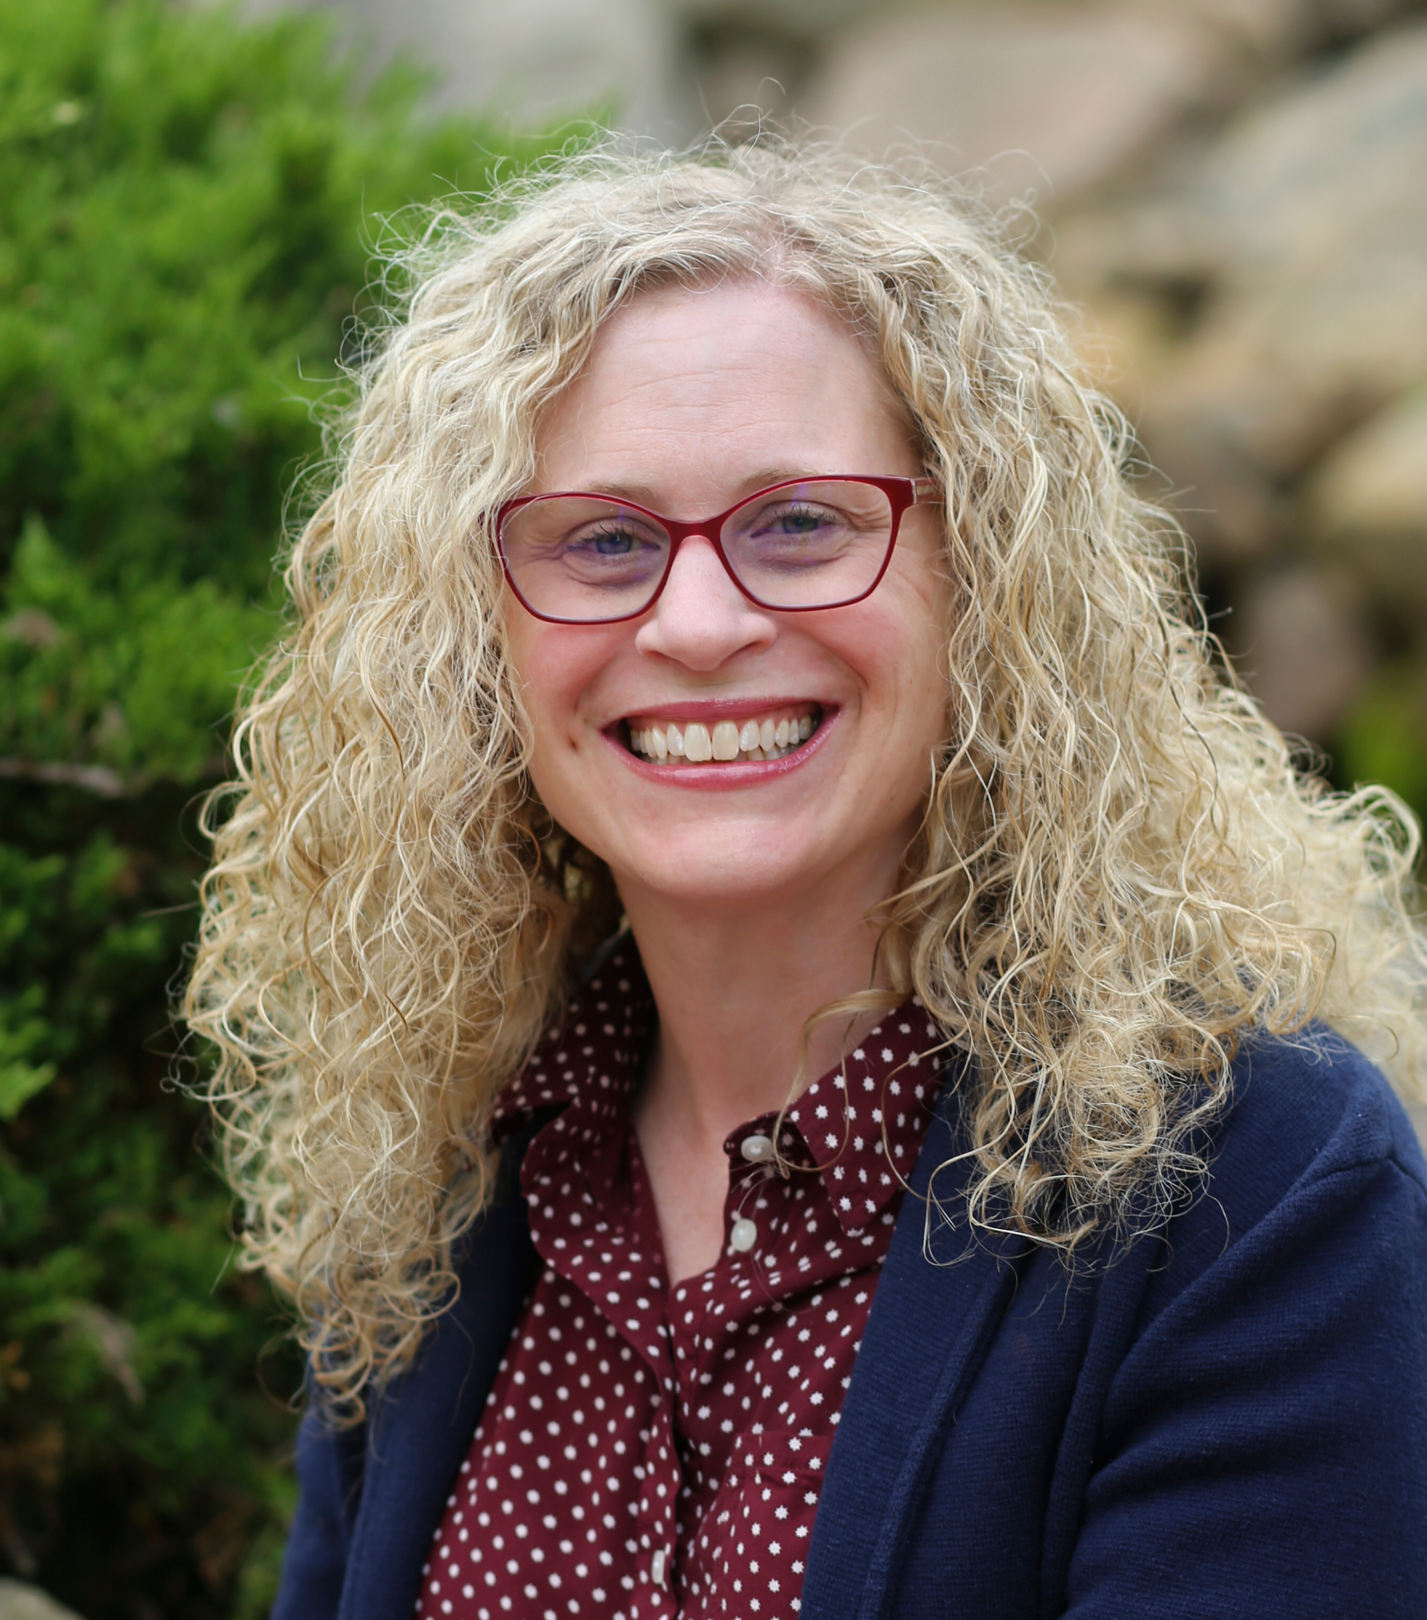
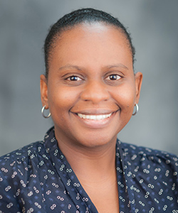
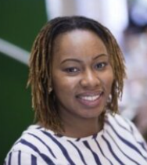
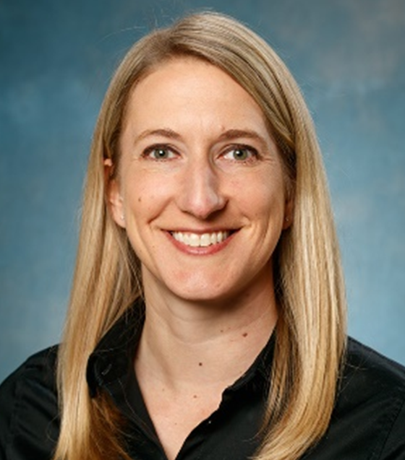




Career Development Awardees
Jennifer Gabbard, MD
Wake Forest School of Medicine
Use of a Dementia-Specific Portal-Based Tool for Advance Care Planning Engagement
Rupak Datta, MD, PhD
Yale School of Medicine
Antibiotic Stewardship in Homebound People Living with Dementia
Komal Patel Murali, PhD
New York University
Rory Meyers College of Nursing
Barriers to Hospice Care Transitions for Diverse Persons Living with Dementia
2020 Award
2021 Award
2022 Award
Tina Sadarangani, PhD, RN
NYU Rory Meyers College of Nursing
Leveraging mHealth to reduce avoidable utilization by people with dementia in day centers
Natalie Douglas, PhD
Central Michigan University
Communication Coaching for Nursing Assistants
Latarsha Chisholm, PhD, MSW
University of Central Florida
GUIDE+ACP Video Interventions Implementation in Nursing Homes
Investigator Award to Promote Diversity
2020 Award
2022 Award
2023 Award
Chanee Fabius, PhD
Johns Hopkins Bloomberg School of Public Health
Engaging and Integrating Direct Care Workers in Care Delivery for PLWD in the Community
Lisa Juckett, PhD, OTR/L
Ohio State University School of Health & Rehab Sciences
Upskilling Care Partners to Provide Nutritional Support for People Living with Dementia
Erica Frechman, PhD
Wake Forest University School of Medicine
Pragmatic EHR Tool to Identify High-Risk Hospitalized Dementia Patients
2021 Award
2022 Award
2023 Award
Cameron Gettel, MD
Yale School of Medicine
Development and Validation of a Novel Caregiver-Reported Outcome Measure
Andrew Kiselica, PhD
University of Missouri
Technology Assistance in Dementia (Tech-AiD)
Rebecca Lassell, PhD, MOT
Indiana University School of Public Health–Bloomington
Adapting Green Activity Prescriptions with Black Persons
2021 Award
2022 Award
2023 Award
Notes:
Nov 3 2023 update
Cameron resubmit K76 for Oct 2023
Andrew Kiselica submit K76 for Oct 2023
Komal Murali Fundable K23 score (waiting on formal NOA – score 28) K23AG083125
Natalie Douglas planned R21 Jan 2024; Also Co-I for P50 but maybe unrelated; LeaRRn Pilot – Learning Health Systems Rehabilitation Research Network

Slide 35







Health Care System Scholars
Jung Kwak, PhD, MSW
University of Texas at Austin, School of Nursing
Co-Designing Care Transition Support for Dementia Patients and Care Partners
Cycle 3
Hillary Lum, MD, PhD
University of Colorado
School of Medicine
Extraordinary Partners in Dementia: UCHealth Capacity for Pragmatic Interventions
Katherine Abbott, PhD, MGS
Scripps Gerontology Center Miami University (Oxford, OH)
Partnering with Providers to Understand IPPI Outcomes of Interest for PLWD
Gail Towsley, PhD, MS, NHA
University of Utah College of Nursing
Building an Academic Long-Term Care System Coalition to Improve Palliative Care
Cycle 1
Cycle 2
Cycle 3
Quincy Samus, PhD, MS
Johns Hopkins University
School of Medicine
Health Care Systems Embedded Research Program: MIND at Home at Centene Corporation
Zainab Osakwe, PhD, NP, RN
Adelphi University
College of Nursing and Public Health
Prioritizing End-of-Life Communication to Reduce Disparities Among PLWD in HHC
Alycia Bristol, PhD, RN, AGCNS-BS
University of Utah
Partnering with UHealth and Rural Facilities to Co-Design ePCT Interventions
Cycle 1
Cycle 2
Cycle 4
Notes:
July 2023 update
Zainab - Submitted two R01s (NINR June 2023 and NIA as MPI July 2023) but informed by work at IMPACT.

Slide 36











2021-2022 Faculty Scholars
Kalisha Bonds, PhD, RN
Emory University Nell Hodgson Woodruff School of Nursing
Design & Statistics Core;
Pilot Studies Core
Jinmyoung Cho, PhD
Baylor Scott & White Health
Health Care Systems Core;
Design & Statistics Core
Fayron Epps, PhD, RN
Emory University Nell Hodgson Woodruff School of Nursing
Pilot Studies Core
Jennifer Gabbard, MD
Wake Forest School of Medicine
Patient & Caregiver Relevant Outcomes Core
Xiaojuan Li, PhD
Harvard Medical School;
Harvard Pilgrim Health Care
Technical Data Core
Miranda McPhillips, PhD, RN
University of Pennsylvania
School of Nursing
Implementation Core
Manka Nkimbeng, PhD, MPH
University of Minnesota
Health Equity Team
Kyra O'Brien, MD
University of Pennsylvania
Engaging Partners Team
Lauren Parker, PhD
Johns Hopkins Bloomberg
School of Public Health
Implementation Core
Tina Sadarangani, PhD, RN
NYU Rory Meyers College of Nursing
Patient & Caregiver Relevant Outcomes Core
Jasmine Travers, PhD, MHS
NYU Rory Meyers College of Nursing
Health Care Systems Core

Slide 37











2022-2023 Faculty Scholars
Talha Ali, PhD
Yale University
Health Equity Team;
Health Care Systems Core
Rupak Datta, MD, PhD
Yale School of Medicine
Health Equity Team
Chanee Fabius, PhD
Johns Hopkins Bloomberg School of Public Health
Health Care Systems Core
Shekinah Fashaw-Walters, MPH, PhD
University of Minnesota
Health Equity Team
Cameron Gettel, MD
Yale School of Medicine
Technical Data Core
Ying-Ling Jao, PhD, RN
Pennsylvania State University
Implementation Core
Zachary Kunicki, PhD
Alpert Medical School of Brown University
Engaging Partners Team
Kylie Meyer, PhD
University of Texas Health Sciences University, San Antonio
Pilot Studies Core
Karen Moss, PhD, RN
The Ohio State University
Engaging Partners Team; Patient & Caregiver Relevant Outcomes Core
Evan Plys, PhD
University of Colorado
Engaging Partners Team
Sandra Shi, MD
Hebrew SeniorLife’s Marcus Institute
Patient & Caregiver Relevant Outcomes Core; Implementation Core
Mark Toles, PhD, RN
University of North Carolina
Patient & Caregiver Relevant Outcomes Core

Slide 38















2023-2024 Faculty Scholars
Alyssa Aguirre, MSW, LCSW
The University of Texas at Austin
Health Care Systems Core
Roman Ayele, PhD, MPH
Veterans Affairs (VA) Denver-Seattle
Center of Innovations
Health Equity Team
Zachary Baker, PhD
Arizona State University Edson School
of Nursing and Health Innovation
Implementation Core
Kuan-Hua Chen, PhD
University of Nebraska Medical Center
Technical Data Core
Natalie Douglas, PhD
Central Michigan University, College of Health Professionals
Implementation Core
Natalie Ernecoff, PhD, MPH
RAND Corporation
Patient & Caregiver Relevant Outcomes Core
Beth Fields, PhD
University of Wisconsin–Madison
Health Care Systems Core
Lisa Juckett, PhD, ORT/L, CHT
The Ohio State University School of Health & Rehabilitation Sciences
Implementation Core
Maria Mora Pinzon, MD, MS, FACPM
University of Wisconsin – School of Medicine and Public Health
Engaging Partners Team
Annalisa Na, PhD
Drexel University College of Nursing
and Health Professionals
Implementation Core
Darina Petrovsky, PhD, RN
Rutgers School of Nursing
Pilot Studies Core
Kendra Ray, MPH, PhD
New York University Grossman School of Medicine
Pilot Studies Core
Guangyu Tong, PhD
Yale School of Public Health
Design and Statistics Core
Tiffany Washington, PhD
The University of Georgia School of Social Work
Patient and Caregiver Relevant Outcomes Core
Emma Zang, PhD
Yale University
Design and Statistics Core

Slide 39





Real World Data Scholars
Jinying Chen, PhD
Boston University Chobanian & Avedisian School of Medicine
Validating Free-text Medication Orders by Leveraging Natural Language Processing
Lindsay White, PhD
University of Pennsylvania Perelman School of Medicine
Determination of Cognitive Status in NH Residents: The Utility of EHR Data
2023 Award
2023 Award
Kenneth Lam, MD, MAS
University of Colorado
School of Medicine
Validation of Functional Measures in LTC EHR Data
Yongkang Zhang, PhD, MS
Weill Cornell Medical College
Evaluating LTC Data Cooperative EHRs to Study T2D among Nursing Home Residents
2023 Award
2023 Award
Notes:
Addstudy title for now, leave departments for now

Slide 40






Investigator Capacity: Training Modalities
ePCT Video Learning Library
Virtual Training Workshop (Annual)
Scientific Conference (Annual)
Notes:
Pics of the actual stuff -

Slide 41
Training Workshop
Building Skills to Conduct Embedded Pragmatic Clinical Trials (ePCTs) among People Living with Dementia (PLWD) and their Care Partner
2021 Workshop
64 attendees
2022 Workshop
87 attendees
Focus Areas:
Health Care Systems and Setting
Implementation
Design and Statistics
Focus Areas:
Health Equity
Ethics and Regulation
Pragmatic Trials with Caregivers
2023 Workshop
79 attendees
2024 Workshop
87 attendees
Focus Areas:
Real World Data
Implementation
Pilot Studies for ePCTs
Focus Areas:
Sample Size Estimation
PLWD and Community Partners
Health Care System Partnerships

Slide 42







Investigator Capacity: Created a Community & Network for Trainees
Broad
Research Community
IMPACT Community
Cores & Teams
IMPACT Trainees
Career Development Awardees
HCS Scholars
Faculty Scholar
Postdoctoral Fellows
Notes:
Outside research community, impact, trainees

Slide 43


Community Engagement: Key Accomplishments
Learning Health Network
36 Organizations
4 Communities
58 Members
Lived Experience Panel
10 PLWD, care partners, and proxies
12 Meetings
3 Reports (1 pending)
        2 Patient & Caregiver Relevant Outcomes
        1 Ethics & Regulation
        1 Health Equity

Slide 44


Community Engagement: Learning Health Network
4 Settings | Explored HCS priorities
Notes:
Add pic from website

Slide 45



Community Engagement: Lived Experience Panels
Selected “example” key takeaways
  Research should ensure…
    studies are designed with input from PLWD & CPs
    all PLWD get the same care
  Interacting with HCS overwhelming…don’t where to go for information especially time of diagnosis
  Outcomes important to PLWD are also complex
How do we meaningfully integrate what is important to PLWD and CPs into ePCT research?

Slide 46
Community Engagement:
Grant Review
5 people living with dementia; 3 care partners
Help make decisions about pilot grant applications
Ensures research matters to people living with dementia
Reviews full proposals; focus on 3 questions
  Is this research important?
  Does this research address an unmet need?
  Will this make a difference in the real-world?

Slide 47


Achieving the Mission
To build the nation’s capacity to conduct ePCTs of interventions within health care systems for PLWD and care partners
Notes:
Add in Learning Health Network
Make building a field bigger

Slide 48

Fulfilling the vision…We still have more work to do!
Vision
To transform the delivery, quality, and outcomes
of care provided to PLWD & their CPs by accelerating the testing
& adoption of evidence-based interventions in HCS

Slide 49
HCS-Data infrastructure for ePCTs: Ingredients
HCS willing to consider conducting a trial
HCS staff and champions have identified unmet need
Researcher has an intervention that might fill that unmet need
EMR able to identify eligible intervention candidates
EMR data linked to Medicare Claims or mortality tracker
EMR or Medicare Claims can be used to track clinical outcomes

Slide 50




“Dream” Real World Data Platform for ePCTs
HCS System EHR
Any Researcher
Claims Data
Conduct ePCT
Randomize sites
Identify/enroll eligible subjects
Characterize subjects & sites
Track outcomes
(Introduce nudge interventions)

Slide 51






Putting It All Together : The Fix
Invest-igator
PLWD
CP
Educate each other
Identify priority amenable to intervention that can be evaluated with ePCT
Design ePCT
Method
Experts
HCS
Leverage real world data platform
Feasibility ePCT
Full ePCT

Slide 52






EHR data curated
NIA Data LINKAGE Program
via 3 data vendors
AHCA approved application
EHR data linked to Medicare claims
2500+ nursing homes
Researcher

Slide 53

Possible Model for GEAR
Yale School Medicine
OR
50+ Geriatric Emergency Departments
NIA Data LINKAGE Program
EHR data curated
De-identified Data Streams
GEAR approved application
EHR data linked to Medicare claims
Researcher

Slide 54
Outstanding Questions
How will ED members of GEAR work with their HCS leadership to get buy-in on a shared data model?
In analyzing combined data from different EDs, how can one keep users blind to HCS identify?
How to recruit EDs to participate in intervention trials?
Is it desirable to link ED EMR data to Medicare claims?

