Slide 1
GEAR 2.0 Pilot Award Round 3 – Budget Template Guidance

Slide 2
Funding for GEAR 2.0 Pilot Awards
GEAR 2.0 Pilot Award funding comes from four sources totaling $150,000 in direct and indirect costs
Source | Total Amount | Indirect Rate
GEAR 2.0-ADC (NIA funded) | $105,000** | 10%
Emergency Medicine Foundation (EMF) | $15,000 | None
Institutional Commitment (Required) | $30,000 | None
Total | $150,000
** includes direct and indirect costs

Slide 3
GEAR 2.0 Pilot Award Budget Template
Structured Excel spreadsheet that automatically calculates based on populated fields
Populate light blue cells with grant specific information
Do NOT change automatically populated fields

Slide 4
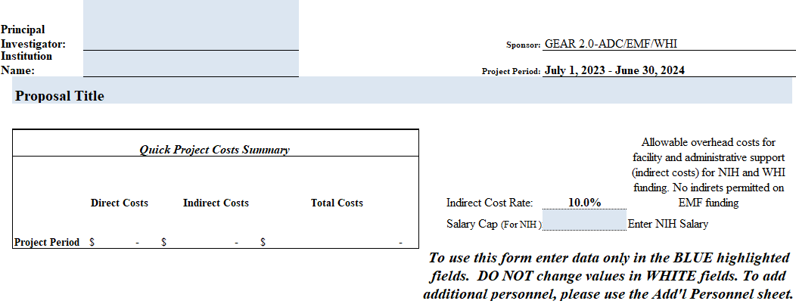
Enter the Principal Investigator’s name and institution
Detailed Budget Worksheet Gear 2.0-ADC/EMF/WHI Pilot Project Grant Funding- Round 3
Overheard rate on GEAR 2.0 fund: Do NOT change
Proposed study title
Overall Cost Summary: Automatically calculated
Enter the current NIH Salary Cap

Slide 5
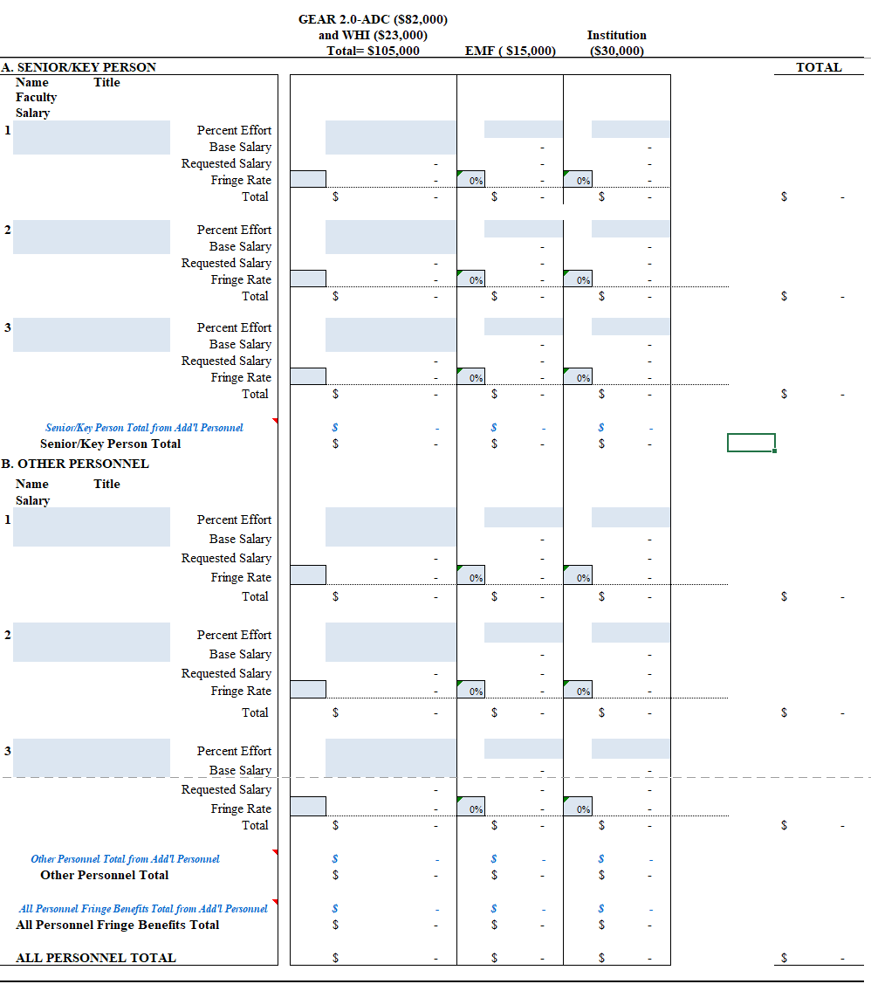
Total per person: Automatically populated
Gear 2.0 ADC
Institutional
Principal Investigator (PI): Information
Co-PI/Multiple PI Information
Total senior/key personnel costs: Automatically populated
Other staff/personnel
Total personnel costs: Automatically populated

Slide 6
Percent effort charged to GEAR 2.0
Percent effort charged to EMF
Percent effort charged to your institution
Total salary requested across funding sources:
Automatically calculated
Base Salary*
Gear 2.0 ADC
Institutional
Name
Title
Institutional fringe rate
Institutional fringe rate: Automatically populated
Base salary Requested salary from your institution: Automatically populated
Requested salary from GEAR: Automatically populated
Base Salary Requested salary from EMF: Automatically populated
*If base salary is greater than NIH salary cap, calculations will automatically adjust to NIH salary cap

Slide 7
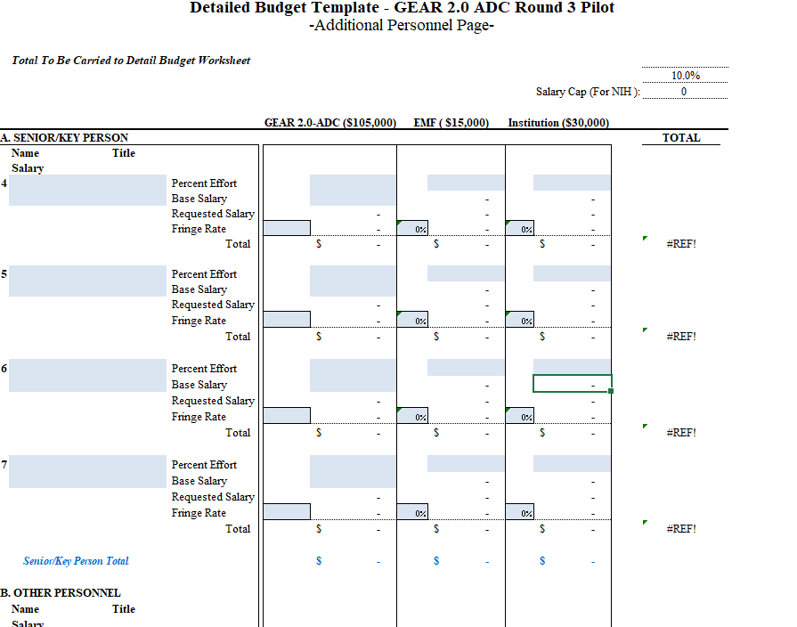
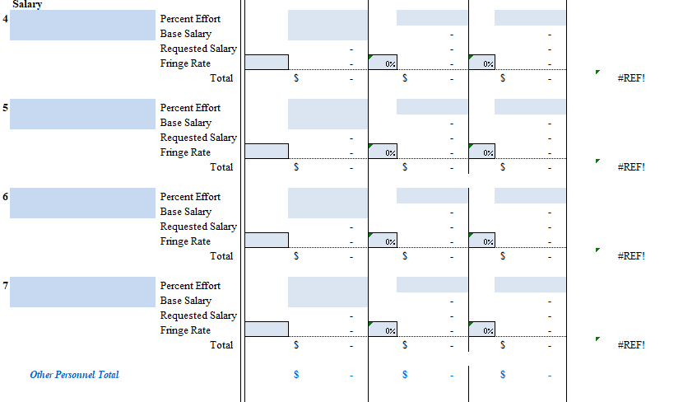
NIH Salary Cap: Automatically populated from “Detailed Budget”

Slide 8
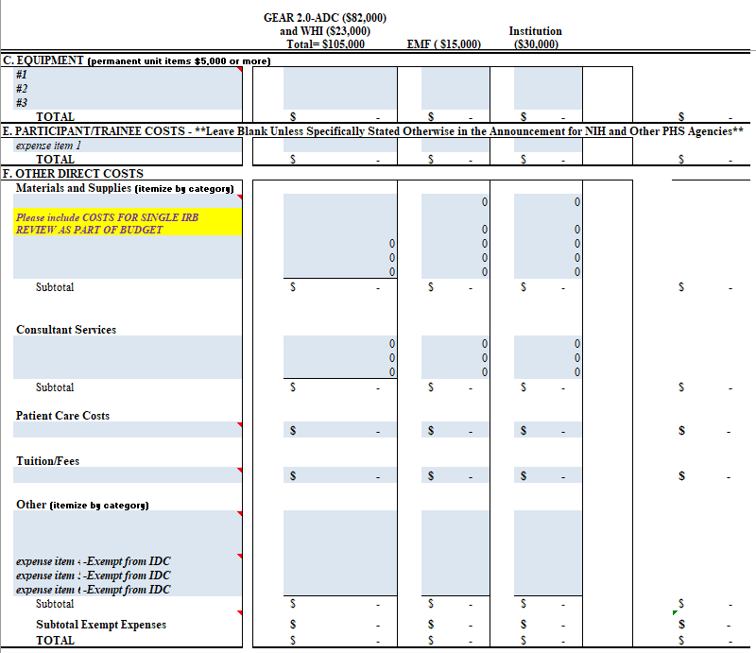
Costs assigned per funding source
Name
Other expenses to be expensed by funding source
Other expense subtotals per category and total other costs: Automatically calculated

Slide 9
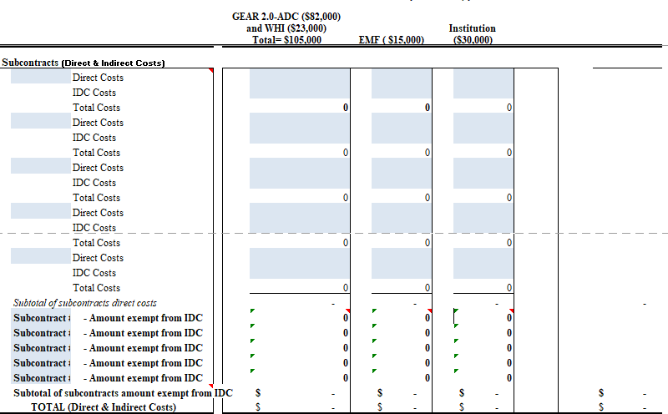
Name/Title for subcontracts
Subcontracts costs: direct and indirect
Sum of direct and indirect costs per contract:
Automatically calculated
The amount of subcontracts EXEMPT from indirect costs*: Automatically calculated
Total subcontract costs:
Automatically calculated
*Can only earn IDC on the first $25,000; Amount beyond $25,000 is automatically excluded from indirect costs

Slide 10
Total expensed charged to EMF (NO indirect costs):
Automatically calculated
* GEAR 2.0 funding MAXIMUM $105,000 * EMF funding MAXIMUM $15,000 * Institution funding MINIMUM $30,000
Total expensed across all funding sources:
Automatically calculated
Total expensed charged to GEAR INCLUDING indirect costs:
Automatically calculated
Total expensed charged to your institution:
Automatically calculated

