Slide 1
Yale GEAR 2.0 Data Core
March 1, 2023
Overview of RADC data sharing and Medicare linkage for emergency care research
Bryan D. James, Ph.D.
Associate Professor, Epidemiologist
Rush Alzheimer’s Disease Center
Dept. of Medicine, Section of Epidemiology Research
Rush University Medical Center
Bryan_James@Rush.edu
Twitter: @BryanDJames
Notes:
Using RADC/Medicare linkages to look at how ED visits may/may not lead to cognitive change
Can request data to look at data for analysis/grant submissions

Slide 2
Funding & disclosures
NIA: R01AG072559; K01AG050823 (completed)
Consultant for:
Alzheimer’s Association (Facts & Figures annual report)
Vivid Genomics, Inc.
Eisai, Inc. (Drug advisory committee 06/30/2022)

Slide 3
Agenda
Intro to RADC Research Resource Sharing Hub
RADC cohort studies
Data documentation, frequency reports
Submitting request for data/specimens
Medicare linkage for RADC cohorts
MedRIC Enclave
Examples of research using RADC + Medicare data
Elective vs nonelective hospitalization and cognitive decline
Hospitalizations, ADRD pathology, and cognitive decline
Notes:
Need login to submit a request for data, but can explore the hub without
DUA approved by MedRIC last week and data now on Enclave

Slide 4
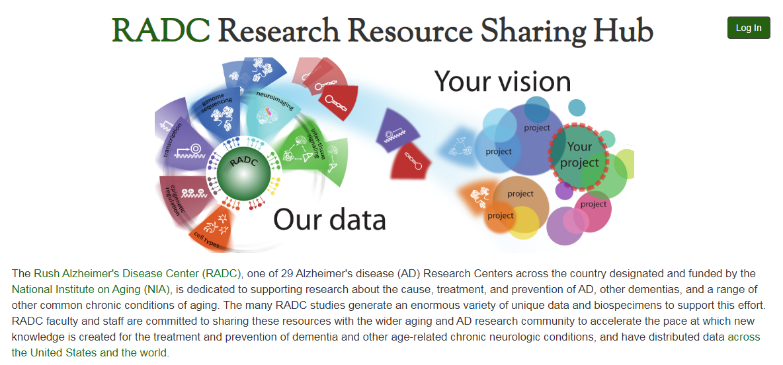
“The Hub”
https://www.radc.rush.edu/

Slide 5
Using the Hub
Browse documentation
Frequency reports
Request data/specimens
Notes:
RADC sharing previously done by email and required familiarity with data
Documented how data was collected and what everything means → Hub

Slide 6
RADC Medicare Linkage
More participants and years now available on NIA Enclave!
(1991-2022)
Notes:
Separate consent form; consent rates have increased over time
Almost 5,000 participants linked across 5 cohorts

Slide 7
MedRIC
https://www.medric.info/
Notes:
Link participants to Medicare claims
Share securely with other researchers
Working with NIA to facilitate
Aging studies with medicare claims that you can request
Setup DUA with NIA and site of study → Can access both sets on data on enclave without having to take data off or be sent data
Study sites pay to house their data there and use
- Can’t observe Medicare Advantage currently. MedRIC is working on adding some

Slide 8
https://doi.org/10.1212/WNL.0000000000006918

Slide 9
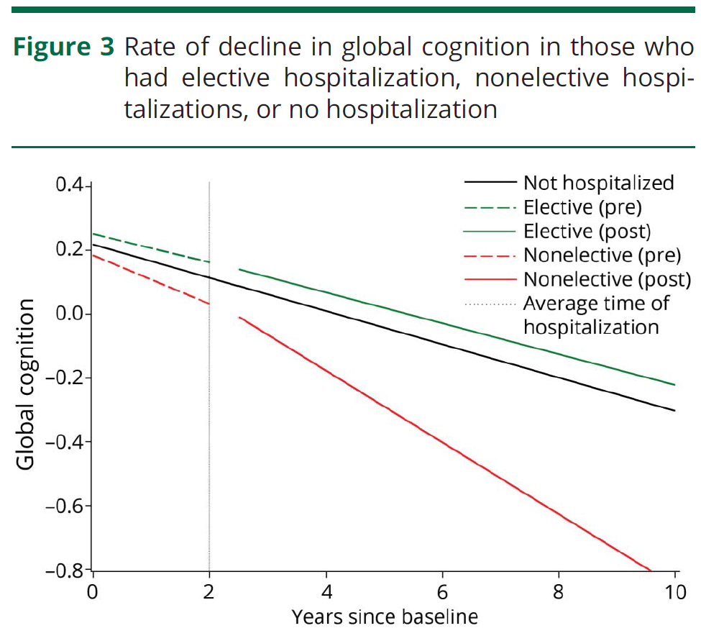

Slide 10
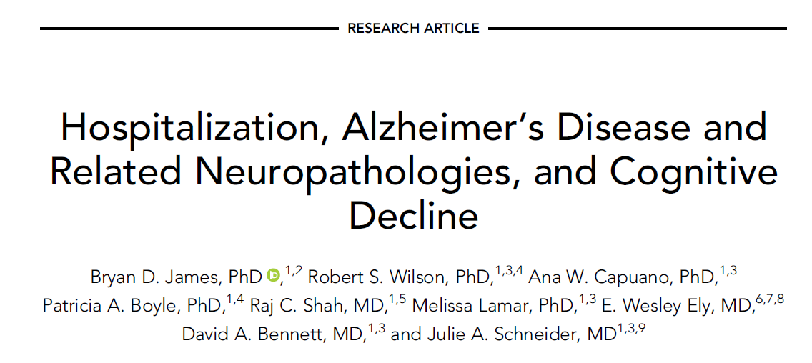
ANN NEUROL 2019;86:844–852 https://doi.org/10.1002/ana.25621

Slide 11
Interaction of hospitalization and tau tangle pathology on rate of cognitive decline
Not hospitalized (blue) vs mean hospitalization rate of 0.5 per year (red);
25th percentile tau tangle density (dotted) vs 75th tangle density (solid).

Slide 12
To do: Emergency Care
Impact of emergency care on cognitive health
Emergency care and other age-related outcomes
ED visits with vs without hospital admission
Understanding factors leading to AD visits in older adults
Racial differences in ED visits

Slide 13
Acknowledgments
RADC Medicare Linkage team
Fran Grodstein, PhD
Yi Chen, PhD
Other RADC faculty & staff
Director: David Bennett, MD
RADC cohort participants
RADC Hub team
John Gibbons
Greg Klein
Maylene Liang
Yan Li
Tiffany Wu
Thank you, Ula and Anna for the invite!

