Slide 1

Recruitment, Engagement, and Retention Core Seminar
November 29, 2022
**This meeting will be recorded**

Slide 2

Agenda
Application and discussion of readings
  Gilmore-Bykovskyi et al. 2021
  Friz et al. 2021
Activity
  RER Appraisal Checklist – Part 1
Looking forward
  CARDS meeting prep and questions

Slide 3
Application and Discussion
Gilmore-Bykovskyi et al. 2021. Traversing the Aging Research and Health Equity Divide: Toward Intersectional Frameworks of Research Justice and Participation.
Main points:
Focusing on individual-level factors of participation, such as an individual’s beliefs about research, imposes a unidirectional moral obligation on participants and requires the participant to align their goals with that of researchers.
Common features of conceptual frameworks of research participation include mutually beneficial relationships, investing in communities, and empowering participants.
  ABCD approach: Asset-Based Community Development
  NGAGE model: Network, Give first, (then) Advocate for research, Give back, and Evaluate (related efforts)

Slide 4
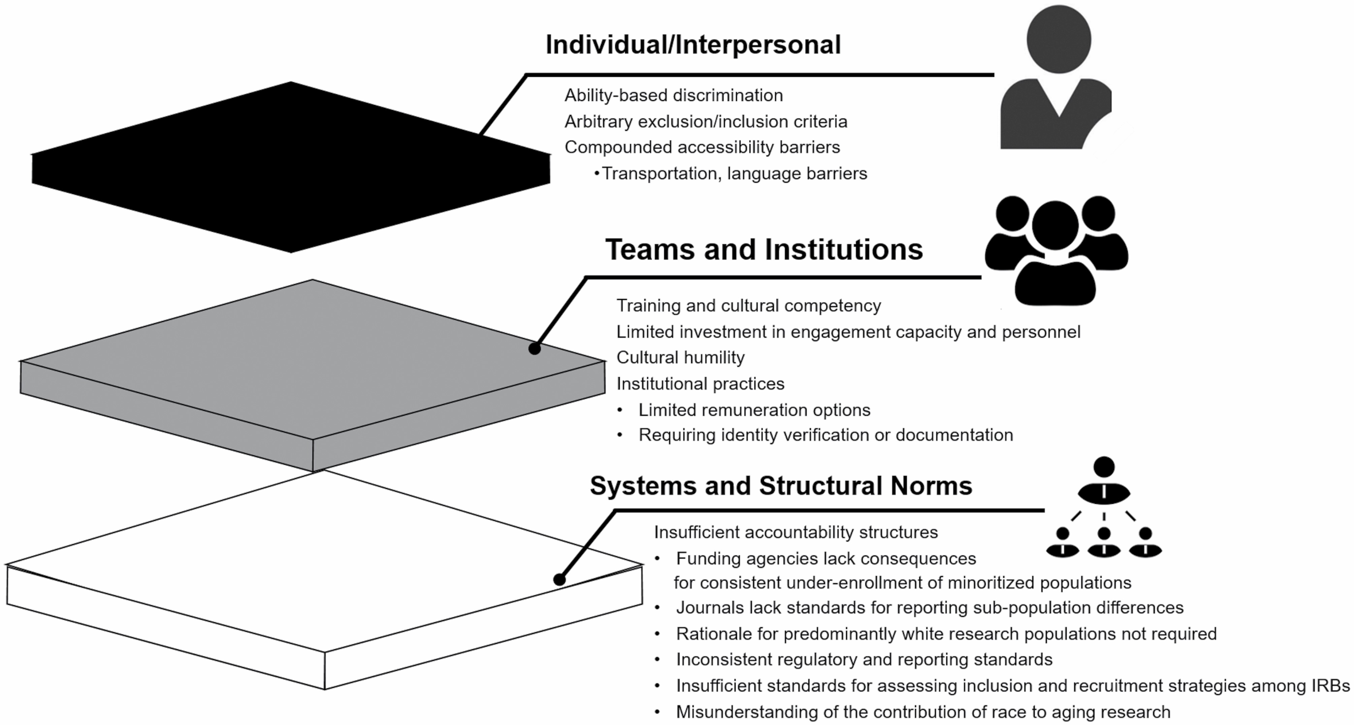
Application and Discussion
Figure 1. Mechanisms that perpetuate exclusion from aging research across intersecting levels of influence
Gerontologist, Volume 62, Issue 5, June 2022, Pages 711–720, https://doi.org/10.1093/geront/gnab107
The content of this slide may be subject to copyright: please see the slide notes for details.

Slide 5
The Participant and Relationship-Centered Research Engagement Model

Slide 6
Application and Discussion
Friz et al. 2021. Tailoring Research Recruitment for Acute Care Settings: Recommendations from People with Dementia and their Caregivers
Main Points:
Research staff attributes and skills may be the most important consideration for acute care recruitment.
Acute care recruitment approaches must consider situation, periods of uncertainty, and preferred timing.
It’s important to seek input on decision-making and recruitment from the person living with dementia.

Slide 7
Application and Discussion
Discussion
Initial reactions to readings. Were there concepts or ideas that are new to you?
What mechanisms of exclusion are active in your own environment and team?
What ways are you already responsive to recruitment strategies identified by Friz and colleagues? What areas would you like to address?

Slide 8
RER Appraisal Checklist – Part 1
Aspects of Research that can Support or Limit Participation
  Level of involvement
  Level of Accessibility
  Eligibility Criteria
  Participation Options
  Caregiving and Transportation Supports
  Ongoing Communications
  Sharing Study Results
  Including Participants from Diverse Backgrounds

Slide 9
Looking Forward
Next Meeting: 1/4/23, 1:30-2:30 pm CST
Workshop selected study materials
  Consider engaging team members in RER Appraisal
CARDS meeting prep/reflection
If you haven’t already, please send RER plan and recruitment materials to Dr. Gilmore-Bykovskyi
  algilmore@wisc.edu

