Slide 1
Data Core Session 1
September 20, 2022

Slide 2
Agenda
Data Resources
Topics of Interest
Next Meeting
Feedback

Slide 3
Data Resources: National Alzheimer’s Coordinating Center (NACC)
Standardized clinical and neuropathological research data (Uniform Data Set [UDS])
  Cores: Administrative, Clinical, Data Management and Statistics, Imaging, Neuropathology, Outreach, Recruitment and Engagement, Biomarker
Built in collaboration with over 42 ADRCs [37 active sites] over 20+ years
45,000+ participants: Ranging from normal cognition to MCI to demented
166,000+ clinical assessments (1-17 per participant [mean=3])
6,980+ neuropathology exams (from 58% of deceased participants)
Data files available
  Quick access: complete UDS and Neuropathology datasets
  Customized: Data request form for specific file criteria
https://naccdata.org/
Notes:
Longitudinal data from 2005
Not statistically based sample of US population → do not lend themselves to estimates pf prevalence or incidence of dementia subtypes in US population
Data collected from participants and co-participants (family or close friend)
Cameron: what kind of clinical data are available in NACC?
Cindy: can you get to all the data through NACC and not need a DUA? Who can access these data?
Can do Queries on NACC directly via online
Ula: send us your questions and ideas of what you want answered about how to use these datasets (like more info from NIA / Nina of how to use NACC).
Kei Cheung and Heather Allore are part of Yale ADRC. And we can ask them if they use NACC data.
Ula: for pilot awardees to connect with their own ADRC and understand how they export and import data to NACC.

Slide 4
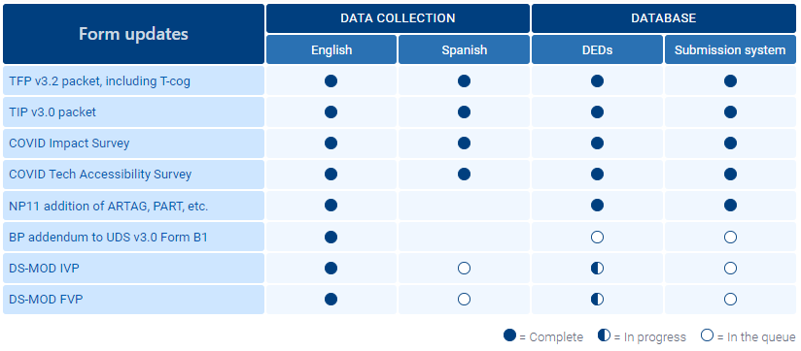
Data Resources: National Alzheimer’s Coordinating Center (NACC)

Slide 5
Data Resources: Standardized Centralized Alzheimer’s and Related Dementias Neuroimaging (SCAN)
Aggregate, harmonize, manage, facilitate sharing of neuroimaging at ADRCs
  MRI: minimum T1 & FLAIR or full protocol mirrors ADNI
  PET: Amyloid Tracers, TAU Tracers, Glucose metabolism tracer
Protocols generally but not exclusively focus on widely accepted biomarkers in A/T/N framework
Data available through NACC and linked to participant ID
  Analyzed data includes: regional measures of amyloid, tau, and FDG tracer uptake, brain volumes, WMH, cerebral infarctions, fractional anisotropy, cerebral blood flow, functional connectivity [advanced MRI sequences]
https://scan.naccdata.org/
Notes:
ADNI: MPRAGE, FLAIR, T2*, DTI, rsfMRI, (ADNI 3 high res hippocampus)
A/T/N framework: Amyloid/Tau/Neurodegeneration

Slide 6
Data Resources: National Centralized Repository for Alzheimer’s Disease and Related Dementias (NCRAD)
Focus on etiology, early detection and therapeutic development on ADRD
Clinical information and biological materials
100,000 subjects with samples
50 studies have samples banked
Individual with ADRD and healthy controls
Complete online data agreement to access catalogs
https://ncrad.iu.edu/
Notes:
Biological materials include DNA, plasma, serum, RNA, CSF, cell lines and brain tissue

Slide 7
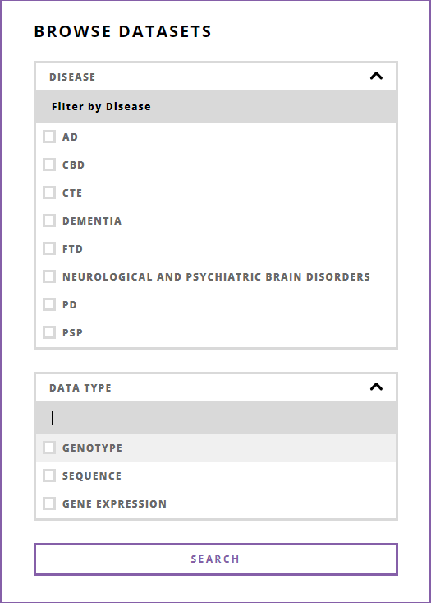
Data Resources: The Nations Institute on Aging Genetics of Alzheimer’s Disease Data Storage Site (NIAGADS)
National genetics repository
  Genetics and genomics of early- and late-onset AD and ADRD
89 datasets
144,242 samples
12 datatypes
Sub-features:
  Alzheimer’s Disease Sequencing Project (ADSP)
  Genome Center for Alzheimer’s Disease (GCAD)
  Alzheimer’s Disease Genetics Consortium (ADGC)
  Genomics Database (GenomicsDB)
Submit requests through Data Sharing Service (DSS)
niagads.org/
Notes:
ADSP: Identify new genomic variants contributing to risk of developing late onset AD, contributing to protection against developing AD, provide insight to why individuals w known risks don’t develop AD, explore these factors in multi-ethnic populations to identify new pathways for disease prevention
GCAD: raw data from NIAGADS → data processing/quality control → variant annotations → analysis ready data back to NIAGADS
ADGC: Identify genetic variants associated with risk for AD
GenomicsDB: enables browsing, searching and analysis of 56 publicly available summary statistics from AD/ADRD genome-wide association studies deposited in NIAGADS

Slide 8
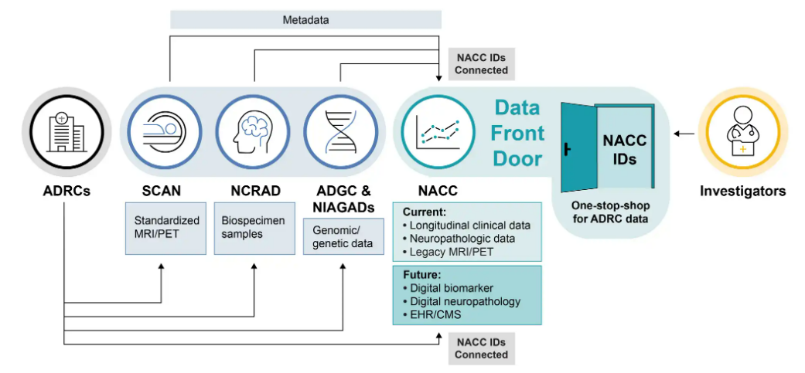
Data Resources: Data Front Door (DFD)
NACC
NCRAD
NIAGADS
SCAN
“One stop shop” for all ADRC data
Harmonize data streams and connect to NACC IDs
Notes:
If we have cognitive impairment status : what longitudinal clinical data available→ NACC’s query system
NACC – ask Nina who could comment
ADRC/Pepper people at Yale – anyone using?
→ Chris VanDyke, Kay, Heather on ADRC informatics how they interact with ADRC
How do other sites connect and use
Cameron: what kind of clinical data are available in NACC?
Cindy: can you get to all the data through NACC and not need a DUA? Who can access these data?
Can do Queries on NACC directly via online
Ula: send us your questions and ideas of what you want answered about how to use these datasets (like more info from NIA / Nina of how to use NACC).
Kei Cheung and Heather Allore are part of Yale ADRC. And we can ask them if they use NACC data.
Ula: for pilot awardees to connect with their own ADRC and understand how they export and import data to NACC.

Slide 9
Data Resources: AD Knowledge Portal
AD data, analyses, and tools from NIA’s AD Translation Research Program
Data resources: AD Knowledge Portal
  AMP-AD: New drug targets for AD treatment and prevention
  M²OVE-AD: Metabolic and vascular etiology of AD
  MODEL-AD: AD animal models
  Resilience-AD: Cognitive resilience under high-risk conditions for AD
  Psych-AD: Molecular mechanisms of neuropsychiatric symptoms in ADRD
  CDCP: Research community data distribution program
  ELITE: Multi-omic data, integrate analytical tools and resources →longevity studies of protective cellular factor(s) that enhance health and life span
  TREAT-AD: Diversifying and reinvigorating AD drug development pipelines
Browse/View data on poral; Register to download data
  Some data controlled access → Data Use Certificate
https://adknowledgeportal.synapse.org/
Notes:
The different omic strategies employed during multiomics are genome, proteome, transcriptome, epigenome, and microbiome.

Slide 10
Data Resources: Health and Retirement Study (HRS)
Longitudinal panel study approx. 20,000 people across US
Multidisciplinary data related to aging
Partnerships/Collaborations
  International Family of Studies
  Harmonized Cognitive Assessment Protocol (HCAP) Network
  Genetic Data Consortia
  Global Alzheimer’s Association Network (GAAIN)
  NIA Demography of Aging Centers
Public and Restricted Datasets
https://hrs.isr.umich.edu/about
Notes:
Representative sample of approx. 20,000 people in US

Slide 11
Data Resources: National Health & Aging Trends Study (NHATS)
Began 2011
Nationally representative sample Medicare beneficiaries 65+
Annual in person interviews
National-level disability trends as well as individual trajectories
Periodically caregivers of NHATS respondents interviewed in National Study of Caregiving (NSOC)
Cross-year searchable database
  Public use and restricted files
Provides data collection materials and procedures
https://www.nhats.org/researcher
Notes:
Tom Gil
Cameron drafted analytic plan using T32 fellows in prior years – had 9-10 years of data from this, needs analytic plan
Dementia and Falls, not ED visits
Jason Falvey has done analyses on 10 years of data with NHATS data. Dementia and falls characterization.
Cameron has these data as a collaborator with Falvey.
No ED visits in NHATS data…

Slide 12
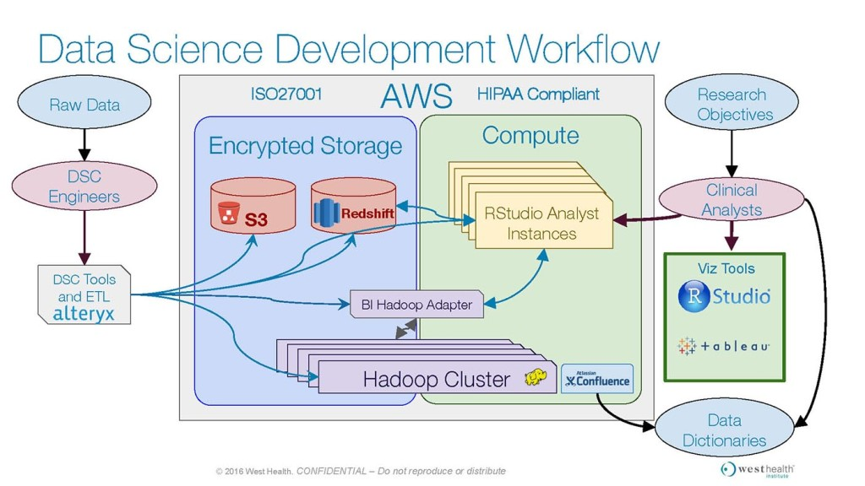
Data Resources: Research Data Warehouse (RDW)
Secure web-interface provide statistical analysis and visualization tools across relevant data
Computational and data resources within same framework
Areas of interest:
  Geriatric emergency care
  Home-based primary care
  Supportive services
  Oral healthcare and care coordination
  Caregivers
https://www.westhealth.org/resources/data-science/
Notes:
West Health overview of RDW and how it functions and what is available in it.
Theoretical framework, some still getting fleshed out
ED encounter specific
-→ way to link ED and other databases in future would be huge
Talk tomorrow @ 1:00 for GEAR1.0
-- what it can and cannot to in theory
Want people to have access to multi-center data
Can’t download data
Cindy: students need well defined data project Python-Jupyter notebooks, R-studio (Andrew, Kei, Samah all have students who need projects) Define project and get access could all benefit from
Cindy – are there other national data sets? NHAMCS?
Cameron – Arjun thinking of buying national datasets to run through stats and descriptives like this annually.
Basmah – national ED data???
CDC, NAMCs (school of public health students to use data)
Susan Busch (chair of health policy, professor) at YSPH has gathered resources like MEDREC and NDI, and purchased these data.
HCUP data
Medicare – issue: have to buy it and need a defined cohort
Program on Aging MEDRic – maybe we could get someone to come talk to us
Nursing home data? CDC

Slide 13
Topics of Interest
Data Resources
  NACC
  SCAN
  NCRAD
  NIAGADS
  AD Knowledge Portal
  HRS
  RDW
  Others?
Data Management tools
  REDCap
  FileMaker → ConnEDCt
  Open Data Kit
  Velos
  Others?
Notes:
OnCore, Qualtrics/FileMaker (problems on back end)
Cindy – push for REDCap, Velos not a bad program; File maker and Qualtrics may have problems with data security and not hipaa compliant so best to stay away. Better to use Redcap. Most of the research community uses it.
ConnEDCt ←built off filemaker but a secure version.
Cameron using REDCap
Anything in particular for REDCap?
Participant enrollment, documentation, contact info, cog screening scores
GEAR2.0 later aim pilot to test AI → send surveys
How to optimize for use for running records, looking at backend
New data export function, data portals
Compile list of videos and put some on website
Ask Mary and/or Katy for topics
Redcap mostly used for participant enrollment and documentation of screening scores, contact info, etc. ← how to optimize it for use on backend for pulling data. POA at Redcap meeting and could demo data portals and exporting capabilities. Mary / katy for demos of Redcap.
For Cameron’s pilot, the final aim is pilot testing of an intervention with a digital health app. There is functionality in the digital health app to collect data. Guidance and permissions that should be put into the data collected for future research use.
Cameron
Design thinking workshops

Slide 14
Topics of Interest
Measurement tools
  Quick Dementia Rating System (QDRS)
    Rapid dementia staging tool
  Dementia Severity Rating Scale (DSRS)
    Informant based questionnaire to assess severity across stages in functional and cognitive domains
  Blessed Orientation-Memory-Concentration Test (BOMC)
    Measure cognitive function in patients with cognitive impairment
  Trail Making Test (TMT) A&B
    Assess cognition
  The Family Confusion Assessment Method (FAM-CAM)
    Identify changes in thinking, concentration and alertness during recent days

Slide 15
Topics of Interest
Measurement tools
  Mini-Mental Status Exam (MMSE) [in person + telephone]
  Telephone Interview for Cognitive Status-modified (TICS-m) [TICS]
  Montreal Cognitive Assessment (MoCA) [in person + telephone]
  Informant Questionnaire on Cognitive Decline in the Elderly (IQCODE)
  Orientation. Memory, Concentration Test (OMCT)
  Eight-item Interview to Differentiate Aging and Dementia (AD8)
  Short Blessed Test (SBT)
  Bergman-Paris Question
  Brief Risk Identification for Geriatric Health Tool (BRIGHT)
  ED Mini-cog
  Ottawa 3DY (O3DY)
  Six-Item Screener (SIS)
  4 ‘A’s Test (4AT)
  The Clock Draw Test
Other topics?
https://pubmed.ncbi.nlm.nih.gov/35940682/
https://www.peppercenter.org/public/gril.cfm
Notes:
Screening tools vs staging/severity
Context matters!
Do they already have diagnosed dementia? What interventions would apply
Screening instruments
In ED there is no standard yet
What is the latest? Where is community?
AD8 Cameron uses fast, in literature

Slide 16
Topics of Interest
Other Measurement Tools
  Abbreviated Mental Test (AMT)
  Alzheimer’s Disease Assessment Scale-Cognitive Subscale (ADAS-Cog)
  Brief Multi-Dimensional Assessment of Dementia Severity
  Gait Speed Dual Task Test
  General Practitioner Assessment of Cognition (CPCOG)
  Hopkins Verbal Learning Test Revised
  Informant Questionnaire on Cognitive Decline (Short Form)
  Memory Impairment Screen (MIS)/Telephone (MIS-T)
  Modified Blessed Dementia Rating Scale
  Modified Mini Mental State Examination (3MS)
  Rey Auditory Verbal Learning Test
  Short Portable Mental Status Questionnaire (SPMSQ)
  Symbol Digit Modalities Test (SDMT)
  Time and Change Test
  Thurstone Word fluency Test
  Verbal fluency (VF)
  Wechsler Digit Span Test
https://www.peppercenter.org/public/gril.cfm

Slide 17
Next Meeting
October 18, 2022 @ 13:00 EST

Slide 18
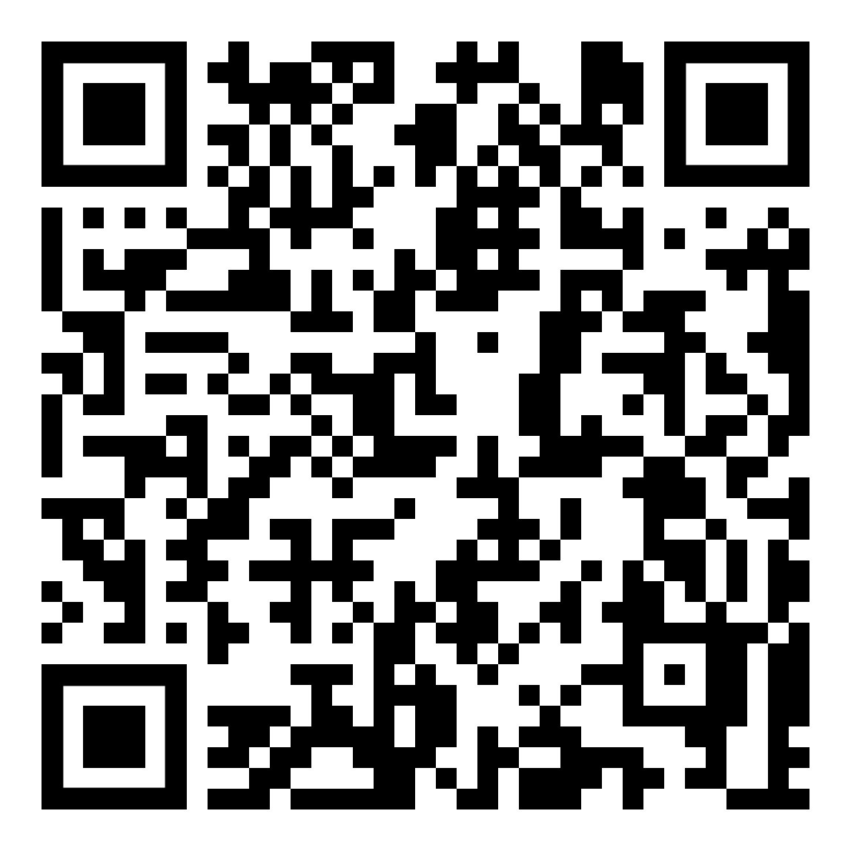
Feedback
Questions/Comments/Reactions
Survey: https://yalesurvey.ca1.qualtrics.com/jfe/form/SV_8Drtr4uxKj6NXMO

